Slide 1


yugabyteDB query plan management (qpm)
sales.person@yugabyte.com
dan.farrell@yugabyte.com
version 0.03

Slide 2
why:
the dark arts, secret sauce, voodoo magic of relational databases
regularly move queries from 5 minutes to sub-second
big (and distributed) systems .. issues get hidden
Objectives for today; query plan mgmt
what:
where this fits in performance tuning
a full query optimizer primer; no pre-requisites, [ any database ]
the 4 stage backend
rules based optimizers, cost based
examples
negations, rewrites
should know basic SQL SELECT
finally, query plan management
demonstration:
alerting on regressions
© 2026 All Rights Reserved

Slide 3
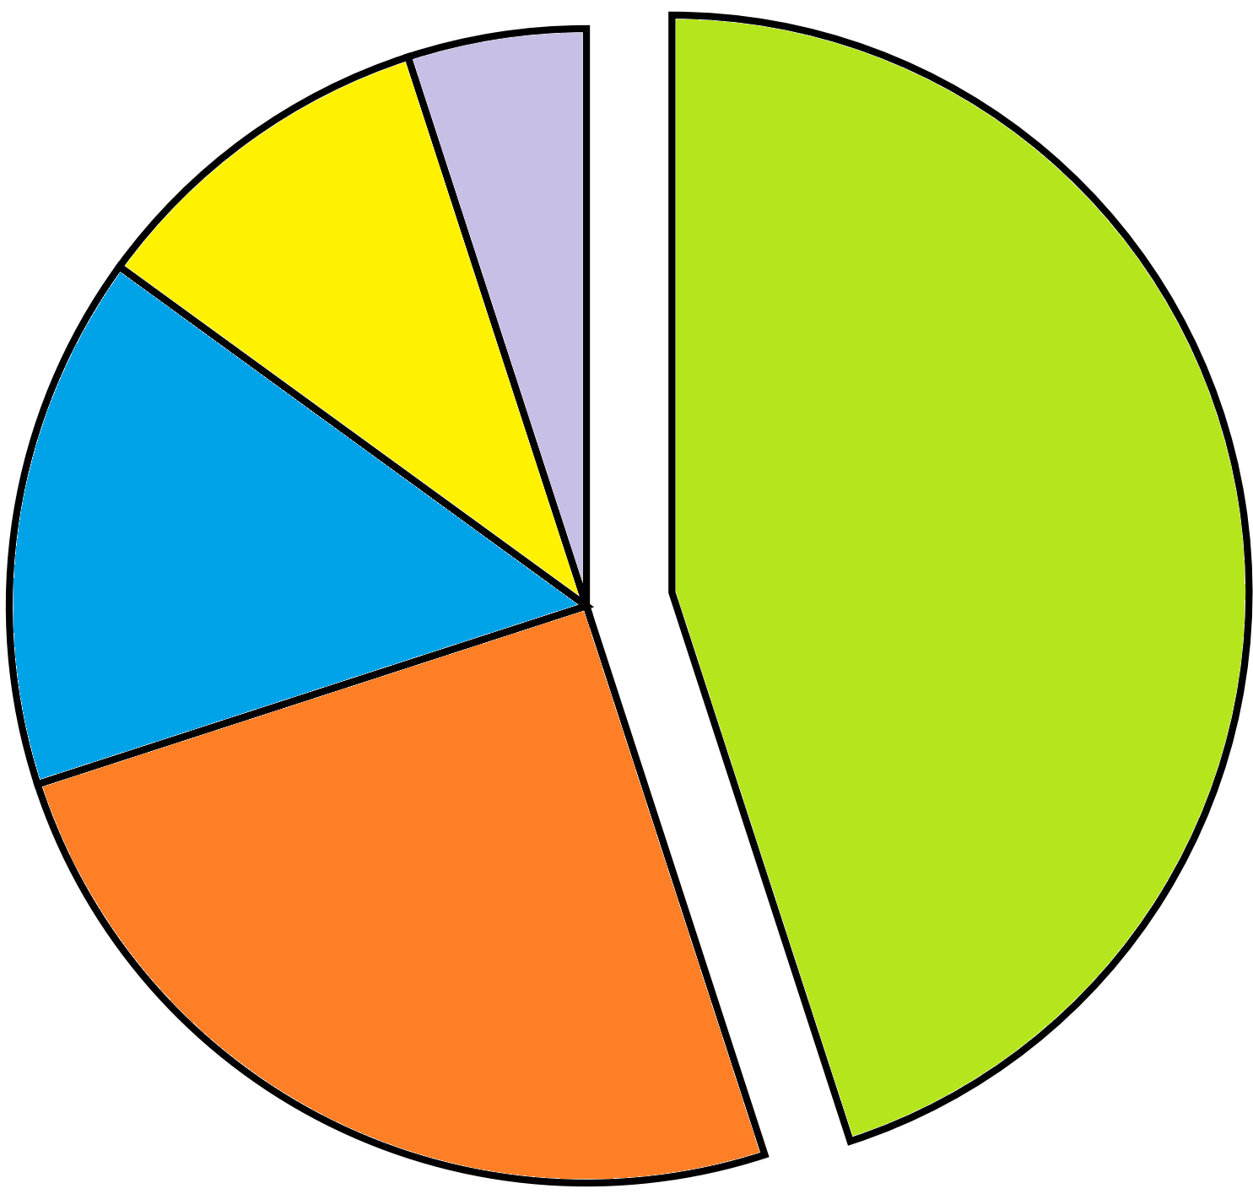
where this fits in performance tuning
5% HW, OS, infrastructure tuning
bad predicates, missing WHERE-clause sargability, unnecessary subqueries, wrong join strategy. consistently the single biggest lever. a single bad query can dominate total load regardless of how well everything else is tuned
10% DB server instance tuning
normalization level, missing/redundant indexes, partitioning strategy, data types sized appropriately. you can't fix a full table scan with a better-written query if the index simply doesn't exist
45% SQL statement tuning
15% application data-access patterns
45% + 25% = 70%
25% schema, index design
N+1 query patterns from ORMs, missing connection pooling, chatty round-trips, lack of batching/caching, wrong isolation level for the workload
memory allocation, buffer/cache sizing, background process config, checkpoint/vacuum tuning, cost-based optimizer settings
storage IOPs, network latency, CPU/RAM sizing, OS-level tuning

Slide 4

sargability – Search ARGument availABLE
Examples;
.. WHERE YEAR(order_date) = 2026
.. WHERE order_date >= '2026-01-01' AND order_date < '2027-01-01'
.. WHERE price * 1.08 > 100
.. WHERE price > 100 / 1.08
.. WHERE cust_id = '1234' -- implicit type cast conversion
.. WHERE cust_id = 1234
all potential forms of "index negation", an abstraction (topic) we will revisit later
index negation: an existing, perfectably good index can not, or should not be used

Slide 5
which of these-
reads ?
writes ?
SELECT
INSERT
UPDATE
DELETE
reads: processing, identifying data that is already present

Slide 6



the 4 stage backend
SQL, declarative
CREATE TABLE (etc) ..
or,
SELECT .. WHERE
UPDATE .. WHERE
DELETE .. WHERE
PREPARE
or the driver, automatic preparation
Parsing phase ?
can be 85% catalog work
authenticate, authorize
read
SQL
write
1.) parser
2.) query optimizer
3.) query processor
client app
data
4.) [ run time libraries ]

Slide 7

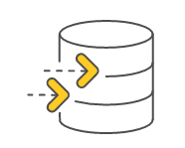
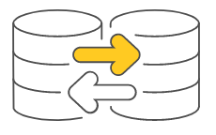
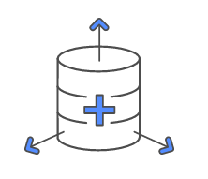
seeing parsing overhead
FOR i = 1 TO 10M
INSERT …
120 seconds ?
or
1.) parser
client app
PREPARE …
FOR i = 1 TO 10M
EXECUTE …
4.) [ run time libraries ]
8 seconds ?

Slide 8
query optimizer; what constitutes a query (execution) plan
file (table) access method
join method
table order
predicate pushdown, filter placement
aggregation strategy
sort elimination (sort pipelining)
subquery transformation
materialization versus pipe lining
parallel execution planning
partition pruning
constants folding, expression simplification
view/CTE inlining

Slide 9
file access methods, (traditionally, all databases)
.. WHERE prod_name = 'Mustard'
index lookup ( O ( log n )) much better at scale
sequential scan ( O ( n ))
…
rowid
prod_num
prod_name
rowid
prod_num
prod_name
H-I x0j3
x0cc
407
Milk
x0cc
407
Milk
J-K x0l1
xocd
411
Bread
xocd
411
Bread
L-Me x0c5
x0e1
402
Cheese
x0e1
402
Cheese
A-G
x0f2
452
Meat
x0f2
452
Meat
A-M
H-M
Mf-Mu xon3
x0f6
422
Eggs
x0f6
422
Eggs
N-Z
N-T
Mv-Mz x0e4
x0m1
419
Batteries
x0m1
419
Batteries
U-Z
…
xon3
444
Mustard
xon3
444
Mustard
…
…
…
…
…
…
…
index types:
b-tree+, (implied above) the oldest sql index type, volatile data, equality and range
hash, second oldest, most performant, equality yes, range no
lsm, log structured merge-tree, modern choice (index ordered tables)
gin
bitmap
(other)

Slide 10
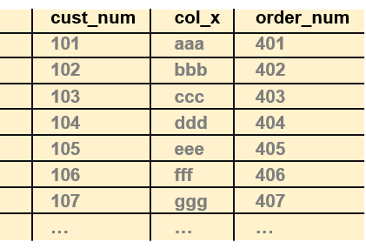
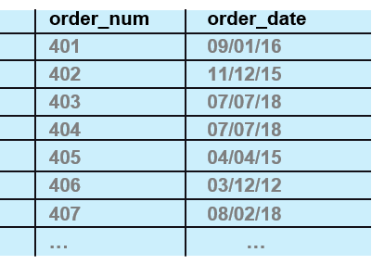
join method, table order
join methods:
nested loop join (implied here), the oldest
batch nested loop join (optimized for distributed)
hash join
merge join (sort-merge)

Slide 11

rules based optimizer (rbo), cost based optimizer (cbo)
rules based optimizer
original
based on sound principles
a decision tree
5 rules applied in order to determine query plan
outer joins
joins
filters
table size
table cardinality
cost based optimizer
same principles (they were not broken)
rbo truths, centered on cost and statistics about the data

Slide 12
example 01
1
2
3
4
5
6
7
8
9
10
difficulty
only because it has 3 simple things going on
one join, two predicates, one order by
© 2026 All Rights Reserved

Slide 13
example 01:
5 rules applied in order to determine query plan
outer joins
joins
filters
table size
table cardinality
select *
from t1, t2
where
t1.col1 = t2.col1
and
t1.col1 = 5
and
t2.col2 > 5
order by
t2.col2;
query plan
file (table) access method
join method
table order

Slide 14
but first, 7'th grade algebra; the associative property
select *
from t1, t2
where
t1.col1 = t2.col1
and
t1.col1 = 5
and
t2.col2 > 5
order by
t2.col2;
select *
from t1, t2
where
t1.col1 = t2.col1
and
t1.col1 = 5
and
t2.col1 = 5
and
t2.col2 > 5
order by
t2.col2;
applies to addition, multiplication
not subtraction, division
in this context,
A = B, B = C, thus A = C

Slide 15
also first; the "psuedo order by clause" (a query rewrite)
select *
from t1, t2
where
t1.col1 = t2.col1
and
t1.col1 = 5
and
t2.col1 = 5
and
t2.col2 > 5
order by
t2.col1, t2.col2;
why-
one index (from one table)
pre-sorted data ( "pipelined sort" )

Slide 16
example 01
solution
© 2026 All Rights Reserved

Slide 17
example 01: determing the query plan, applying the rules
select *
from t1, t2
where
t1.col1 = t2.col1
and
t1.col1 = 5
and
t2.col1 = 5
and
t2.col2 > 5
order by
t2.col1, t2.col2;
outer joins
joins
filters
table size
table cardinality
not present
all tables joined (common, 2nd table+)
98% of the time (determines first table)
(not needed)
(not needed)
filter → join → sort FJS
worse table first
make the nested, repetitive action the most efficient
huh ?
the nested table will likely have the best access method
as efficiently as possible, reduce the number of tuples to be processed

Slide 18
example 01: which query predicate (filter)
5 rules applied in order to determine query plan
outer joins
joins
filters
table size
table cardinality
select *
from t1, t2
where
t1.col1 = t2.col1
and
t1.col1 = 5
and
t2.col2 > 5
order by
t2.col2;
(estimating) filter selectivity
equality on unique index, 1 tuple
equality on duplicate index, heuristic, 100 tuples
range on duplicate index, heuristic/complicated, historically it was 1/3 of tuples
(we) run queries to count and measure

Slide 19
example 01: how, why
…
where
t1.col1 = t2.col1
and
t1.col1 = 5
and
t2.col1 = 5
and
t2.col2 > 5
order by
t2.col1, t2.col2;
best access method: indexed read into t2 (col1, col2)
(table order set, t2 → t1)
best access method: indexed read into t1 (col1)
SQL, table relationships (cardinality)
1:1, M:M, 1:M, 98% are 1:M
t1 was our parent, t2 a child (count the join pairs)
join method
determined (supported by) available indexes
small tables can alter this

Slide 20
example 01: the actual code behind this
-- Explicit HASH primary key (yugabyteDB's preferred PK syntax) rather
-- than the bare "col1 INT PRIMARY KEY" shorthand, which defaults to a
-- range-sharded (ASC) index here. col1 is a monotonically increasing
-- sequence (1..100,000) -- range sharding on that would hotspot writes
-- onto one tablet range at a time; hashing spreads rows evenly across
-- tablets by hash(col1) instead.
CREATE TABLE t1 (
col1 INT,
col2 INT,
col3 TEXT,
PRIMARY KEY (col1 HASH)
);
-- 100,000 rows, col1 = 1..100,000 (unique -- the join key)
INSERT INTO t1 (col1, col2, col3)
SELECT g, 1 + (g % 1000), repeat('x', 50)
FROM generate_series(1, 100000) AS g;

Slide 21
example 01: the actual code behind this
-- Composite primary key (col1, col2): col1 carries the equality
-- join/filter (t1.col1 = t2.col1 = 5), col2 the range filter (> 5) --
-- putting both in the PK lets the planner satisfy the WHERE clause with
-- a single index scan instead of a 1,000,000-row seq scan, AND return
-- rows already in col2 order within that col1 value, which can let it
-- skip the separate Sort step for "order by t2.col2" too.
--
-- col1 leads with HASH for the same reason as t1's PK above -- its
-- generator cycles 1..100,000 repeatedly, so a range-sharded leading
-- column would hit tablets in the same moving-sequential-hotspot
-- pattern. col2 stays ASC (range): the col2-sorted-within-a-col1-value
-- guarantee this key exists for lives inside each hash bucket, so
-- hashing col1 doesn't disturb it.
--
-- (col1, col2) is guaranteed unique by construction below -- the 10
-- rows sharing a given col1 land 100,000 generate_series steps apart,
-- and 100,000 mod 997 (col2's modulus, chosen prime) is nonzero, so
-- those 10 rows' col2 values never collide.
CREATE TABLE t2 (
col1 INT,
col2 INT,
col3 TEXT,
PRIMARY KEY (col1 HASH, col2 ASC)
);
…

Slide 22
example 01: the actual code behind this
…
-- 1,000,000 rows, col1 cycles 1..100,000 so every t1.col1 value has
-- exactly 10 matching rows in t2 -- guarantees the exercise query's join
-- actually returns rows (t1.col1 = 5 alone matches 10 rows in t2).
--
-- col2 uses modulus 997 (prime), NOT 1000: 1000 divides evenly into
-- 100,000, so a col1-cycle-aligned modulus for col2 would make col2
-- fully determined by col1 -- every row sharing a col1 value would get
-- the identical col2 value, and "t2.col2 > 5" would then either match
-- all or none of them instead of a realistic subset.
INSERT INTO t2 (col1, col2, col3)
SELECT 1 + (g % 100000), 1 + (g % 997), repeat('x', 50)
FROM generate_series(1, 1000000) AS g;

Slide 23
example 01: running the original query
EXPLAIN (ANALYZE)
select *
from t1, t2
where
t1.col1 = t2.col1
and
t1.col1 = 5
and
t2.col2 > 5
order by
t2.col2;

Slide 24
example 01: output from ANALYZE
QUERY PLAN
----------------------------------------------------------------------------------------------
Nested Loop (cost=42.19..43.56 rows=10 width=118) (actual time=1.554..1.567 rows=9 loops=1)
-> Index Scan using t2_pkey on t2 (cost=21.10..22.19 rows=10 width=59) (actual time=0.927..0.929 rows=9 loops=1)
Index Cond: ((col1 = 5) AND (col2 > 5))
-> Materialize (cost=21.09..21.25 rows=1 width=59) (actual time=0.069..0.069 rows=1 loops=9)
-> Index Scan using t1_pkey on t1 (cost=21.09..21.25 rows=1 width=59) (actual time=0.613..0.615 rows=1 loops=1)
Index Cond: (col1 = 5)
Planning Time: 12.405 ms
Execution Time: 2.035 ms
Peak Memory Usage: 202 kB
(9 rows)
associative principle automatically applied
pseudo order-by clause automatically applied, pipelined sort
how do we know that (next page)
why not
batch nested loop join (small data volumes)
hash join (we had indexes on both sides)
sort-merge (we had indexes, and high selectivity)

Slide 25
example 01b: a different version, that needs to sort
QUERY PLAN
--------------------------------------------------------------------------------------------------
Sort (cost=47.03..47.11 rows=30 width=118) (actual time=2.454..2.456 rows=29 loops=1)
Sort Key: t2.col2
Sort Method: quicksort Memory: 29kB
-> YB Batched Nested Loop Join (cost=42.19..46.30 rows=30 width=118) (actual time=2.081..2.100 rows=29 loops=1)
Join Filter: (t1.col1 = t2.col1)
-> Index Scan using t1_pkey on t1 (cost=21.09..21.74 rows=3 width=59) (actual time=1.305..1.307 rows=3 loops=1)
Index Cond: (col1 = ANY ('{5,6,7}'::integer[]))
-> Index Scan using t2_pkey on t2 (cost=21.10..24.56 rows=30 width=59) (actual time=0.747..0.754 rows=29 loops=1)
Index Cond: ((col1 = ANY (ARRAY[t1.col1, $1, $2, ..., $1023])) AND (col2 > 5))
Planning Time: 15.893 ms
Execution Time: 3.049 ms
Peak Memory Usage: 641 kB
(12 rows)

Slide 26
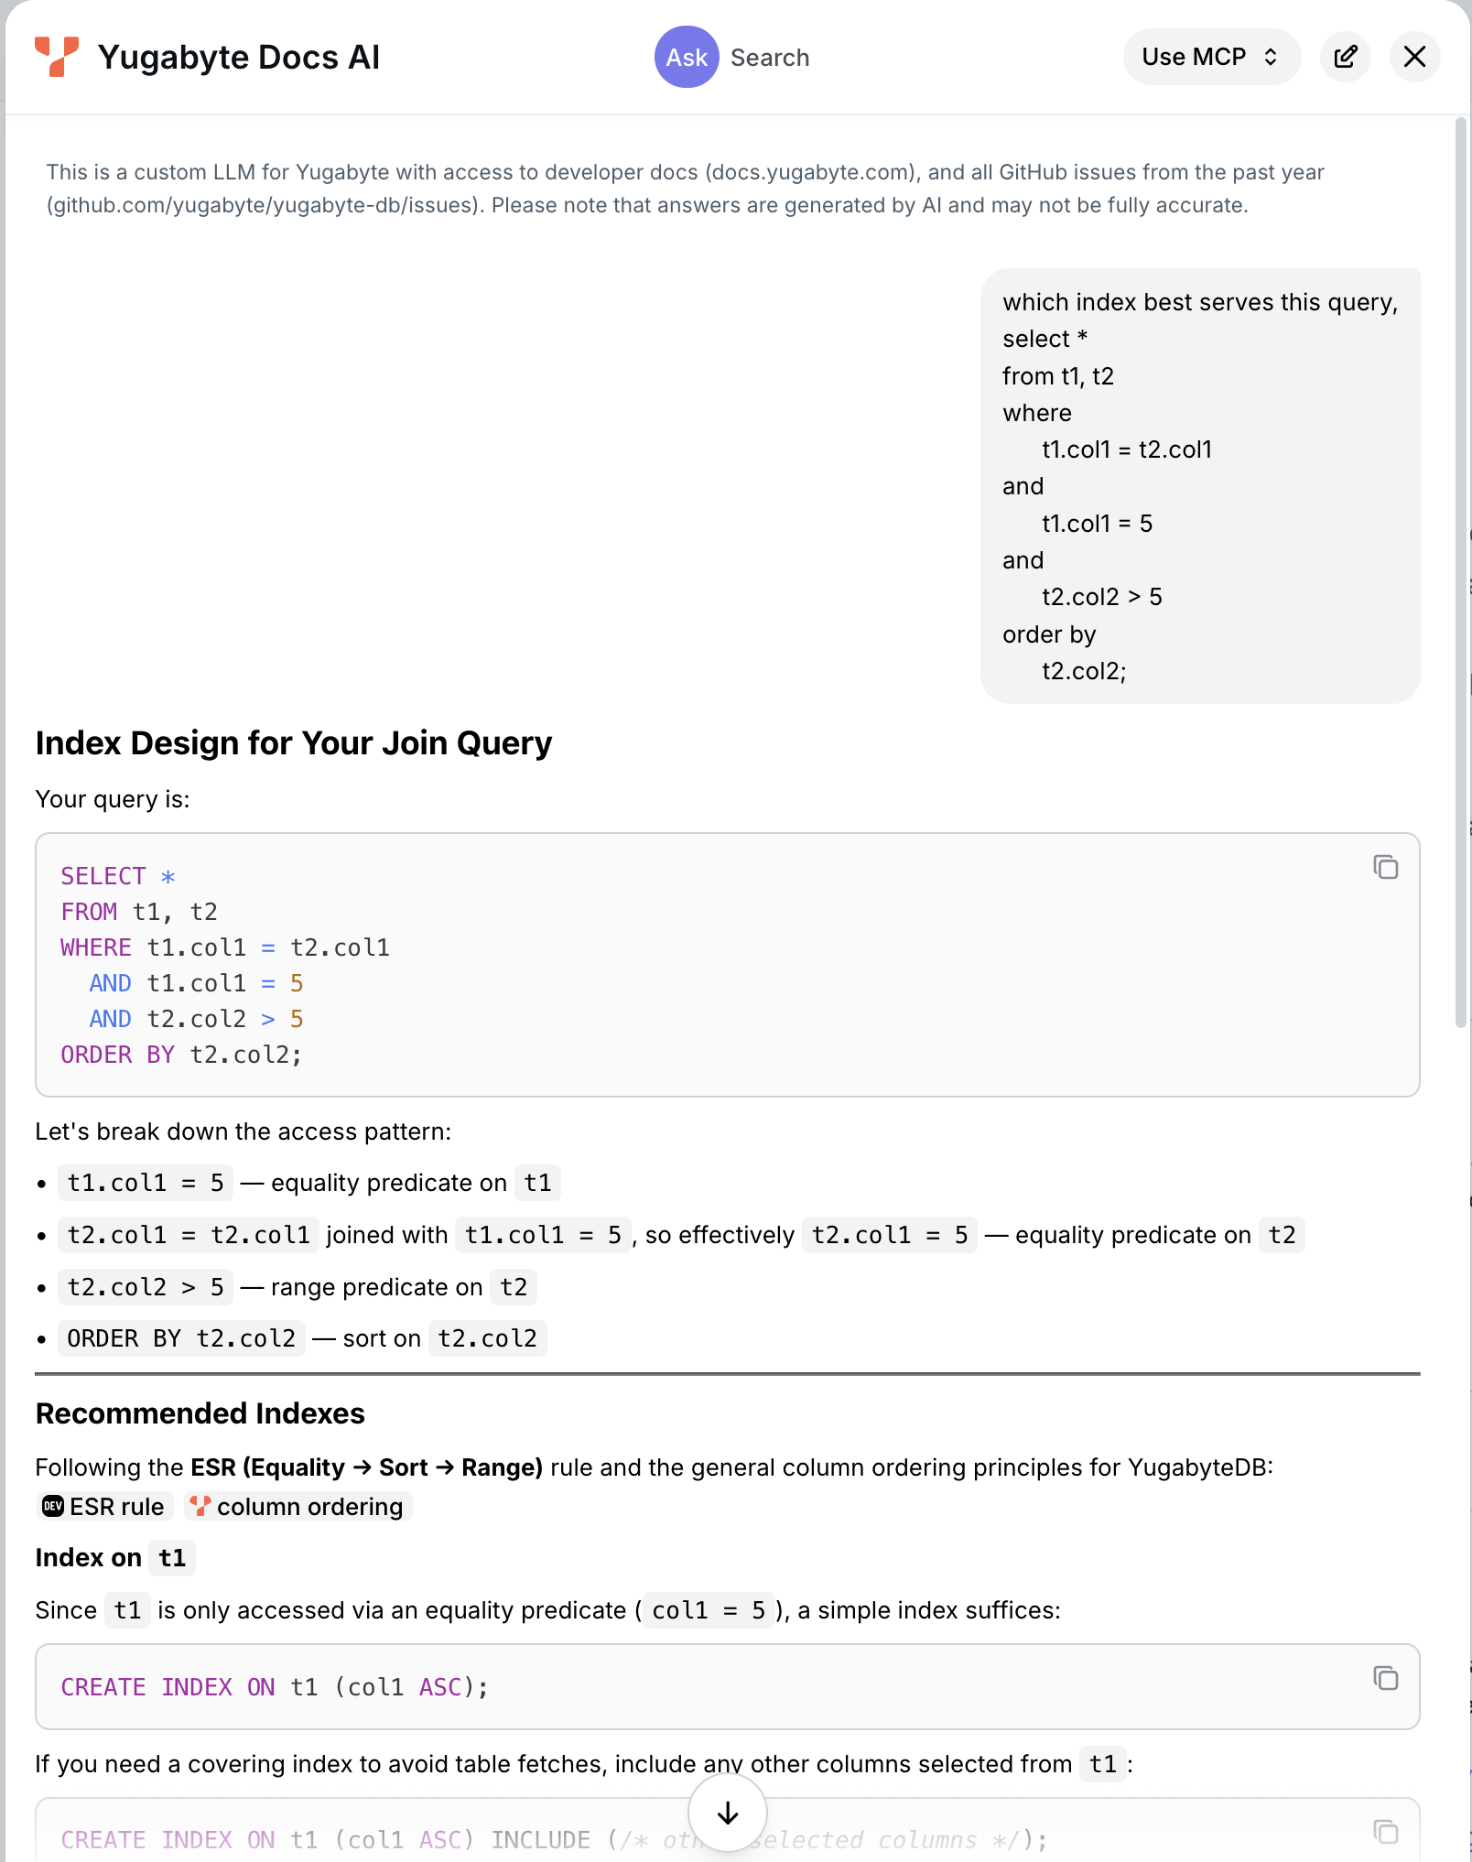
yugabyteDB doc page: Ask AI capability
docs.yugabyte.com

Slide 27
more on sort pipelining
which single index is best ?
what is the column order ?
given an index on (col1, col3) that returns 100,000 rows
and an index on (col2) that returns 100 rows
which access method is better ?
what if the application (pages) and the user rarely reads more than 5 rows ?
select *
from t1
where
col1 = 'X'
and
col2 = 'Y'
order by
col3;
first row first, versus total data set performance

Slide 28
ballpark; where can we make a 5 minute query run in sub-second ? (network tuning, OS tuning, ..)
what is index negation ? give an example
besides SELECT, name two query verbs that read
name the 4 stages in the backend that queries go thru
which two does CREATE TABLE experience ? why ?
how can you bypass the parser ? why would you want to ?
what are the 3 primary elements of a query plan and which one pretty much drives the whole process ?
name two file access methods
name two join methods
our two table query, both tables with predicates; what additional two query topics did we introduce here ? briefly describe each
.. WHERE col1 = 'FFF' and col2 > 20; knowing nothing else, which predicate returns more rows ? which predicate do we prefer to process first ?
what is sort pipelining ?
checkpoint
© 2026 All Rights Reserved

Slide 29
example 01
hands on exercise
exercise 01
exercise 01b (shows sort)
© 2026 All Rights Reserved

Slide 30
example 02
1
2
3
4
5
6
7
8
9
10
difficulty
one new index negation, one new query rewrite
one table, two uncompounded predicates
© 2026 All Rights Reserved

Slide 31
example 02:
5 rules applied in order to determine query plan
outer joins
joins
filters
table size
table cardinality
select *
from t1
where
col1 = 10
or
col2 = 20;
query plan
file (table) access method
join method
table order

Slide 32
the OR-topped query, the physics
tuples could include-
age = 30 and state = 'WI'
age = 10 and state = 'CO'
neither
both age = 30 and state = 'CO'
how you query process can not affect the result set
huh ?
a given tuple can not be returned twice (in error) because of your chosen query processing
select *
from population
where
age = 30
or
state = 'CO';

Slide 33
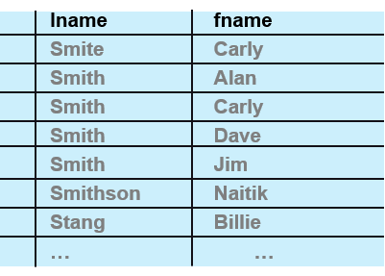
index negation; non-anchored composite key
phone book
sorted (composite indexed) descending by last name, then first name descending
find all persons with first name, Carly
first name is not the first column, not the anchor column
index is now unanchored (data is not sorted by first name)
more performant to be a sequential scan
unless it is key-only (discussed later, but doesn’t help us here)
there is no single index serving (anchored) by both columns

Slide 34


composite key, index negation chart
col1
col2
col3
=
=
=
this: generally,
index type discussion later
=
=
=
=
>
=
col2, if defined as ASC, col3 not used for query
<> NOT
based on expected selectivity
=
<>
NOT
col2 based on selected selectivity
=
if the retrieval is secondary key only, but ..
…

Slide 35
OR-topped query → OR-union transfer (a query rewrite)
select * from t1 where
where col1 = 10
union all
select * from t1
where col2 = 20;
when-
both predicates are indexed
both predicates are selective
use union all when
both predicates produce a unique result set
most performant
use union when
there might be duplicates in the two result sets
(sorts both lists, merge, remove duplicates), blecht
select *
from t1
where
col1 = 10
or
col2 = 20;
select * from t1 where
where col1 = 10
union
select * from t1
where col2 = 20;

Slide 36
example 02
solution
© 2026 All Rights Reserved

Slide 37
example 02: determing the query plan, applying the rules
outer joins
joins
filters
table size
table cardinality
not present
all tables joined (common, 2nd table+)
98% of the time (determines first table)
(not needed)
(not needed)
select *
from t1
where
col1 = 10
or
col2 = 20;
filter → join → sort FJS
only one table; no join methods, no table order, pick a predicate-
because of the chance a row would qualify for both access methods, we need to sort, merge, remove duplicates
without a manual or automatic OR-union transfer, historically this would only ever be sequential access method

Slide 38
example 02: the actual code behind this
-- Explicit HASH primary key -- see "10 - create exercise 01.sql" for
-- why (col1 is a monotonically increasing sequence; hashing avoids a
-- moving-sequential-hotspot on writes).
CREATE TABLE t1 (
col1 INT,
col2 INT,
col3 TEXT,
PRIMARY KEY (col1 HASH)
);
-- 100,000 rows, col1 = 1..100,000 (unique), col2 = 1..1,000 (repeating)
-- -- ~100 rows match col2 = 20, plus the single col1 = 10 row.
INSERT INTO t1 (col1, col2, col3)
SELECT g, 1 + (g % 1000), repeat('x', 50)
FROM generate_series(1, 100000) AS g;
-- col2 has the same repeating-cycle shape as col1, so HASH here too --
-- same write-hotspot reasoning as everywhere else in this lab.
CREATE INDEX t1_col2_idx ON t1 (col2 HASH);

Slide 39
example 02: running the query
EXPLAIN (ANALYZE)
select *
from t1
where
col1 = 10
or
col2 = 20;

Slide 40
example 02: output from ANALYZE
QUERY PLAN
------------------------------------------------------------------------------------------------------
YB Bitmap Table Scan on t1 (cost=78.55..98.96 rows=101 width=59) (actual time=2.594..2.605 rows=101 loops=1)
-> BitmapOr (cost=54.46..54.46 rows=101 width=0) (actual time=0.954..0.954 rows=101 loops=1)
-> Bitmap Index Scan on t1_pkey (cost=0.00..21.22 rows=1 width=0) (actual time=0.612..0.612 rows=1 loops=1)
Index Cond: (col1 = 10)
-> Bitmap Index Scan on t1_col2_idx (cost=0.00..33.19 rows=100 width=0) (actual time=0.338..0.338 rows=100 loops=1)
Index Cond: (col2 = 20)
Planning Time: 11.312 ms
Execution Time: 3.253 ms
Peak Memory Usage: 190 kB
(9 rows)
because both predicates are supported via indexes, the OR-union transfer functional equivalent is automatically applied (a query rewrite)
other access methods output tuples. bitmap index scan outputs tuple ids (not column values proper). this means we will need to go also to the data page once the result sets are formed. (not a candidate for covering indexes, discussed later.)
bitmap index scan supports efficient; BitMapOr(s), BitMapAnd(s)
BitMapOr, grossly efficient means to intersect two result sets
more notes on next page-

Slide 41
example 02: additional topics
to be aware of-
this is named OR "topped", but it applies to any OR inside a query at any level in the WHERE clause. all ORs cause this branching.
!= and <> can, in given cases, be transformed to an OR
currently, if this doesn't fit in work_mem, this automatic query rewrite will fall back to sequential scan
work_mem
all databases have this; (working) memory or virtual memory (temporary tables, files)
default 4MB, one allocation per each of sort/hash/aggregate/node/query
SET work_mem = '64MB'; -- session only, 'session level setting'
SET LOCAL work_mem = '64MB'; -- just this one transaction
ALTER DATABASE my_db SET work_mem = '64MB'; -- per database
ALTER ROLE my_role SET work_mem = '64MB'; -- per user
ysql_pg_conf_csv, work_mem=64MB -- yb-tserver

Slide 42
example 02'ish: a different query, seeing work_mem and sorts
SET work_mem = '16MB';
EXPLAIN (ANALYZE)
select *
from t1
order by
col2;
QUERY PLAN
-----------------------------------------------------------------------------------
Sort (cost=21562.22..21812.22 rows=100000 width=59) (actual time=267.715..279.740 rows=100000 loops=1)
Sort Key: col2
Sort Method: quicksort Memory: 13229kB
-> Seq Scan on t1 (cost=21.09..13257.40 rows=100000 width=59) (actual time=2.579..241.263 rows=100000 loops=1)
Planning Time: 10.982 ms
Execution Time: 293.255 ms
Peak Memory Usage: 19755 kB
(7 rows)

Slide 43
example 02'ish: a different query, seeing work_mem and sorts
SET work_mem = '4MB';
EXPLAIN (ANALYZE)
select *
from t1
order by
col2;
QUERY PLAN
-----------------------------------------------------------------------------------
Sort (cost=25324.72..25574.72 rows=100000 width=59) (actual time=266.545..271.658 rows=100000 loops=1)
Sort Key: col2
Sort Method: external merge Disk: 6768kB
-> Seq Scan on t1 (cost=21.09..13257.40 rows=100000 width=59) (actual time=2.290..234.344 rows=100000 loops=1)
Planning Time: 10.003 ms
Execution Time: 285.005 ms // what ??
Peak Memory Usage: 5238 kB
(7 rows)

Slide 44
example 02'ish: a different query, sort time jitter on small sized data
The Sort node’s own actual time=X..Y numbers mix two different things: X (time to first row) already includes the child Seq Scan’s full time plus the sort itself, since Sort is a blocking operator.
So Execution Time differences between runs were mostly driven by the Seq Scan underneath — which is identical logic either way and, on this shared cluster, varied noisily between 237ms and 289ms across otherwise-identical runs, dwarfing whatever the sort itself costs.
Subtracting the scan’s own time from the sort’s start time isolates the actual sort cost:
run in-memory quicksort external merge (disk)
1 29.7ms 32.5ms
2 25.9ms 34.0ms
3 26.7ms 36.4ms
avg ~27.4ms ~34.3ms
Once the scan noise is stripped out, the disk-spilling sort is consistently slower, as expected — quicksort has no I/O to pay for.
The one-off result in the slides where the disk version looked faster was Execution Time being dominated by scan-time jitter on the shared cluster, not anything about the sort method itself.
Total Execution Time isn’t a reliable way to compare these two — the scan noise (tens of ms) is larger than the real sort-method difference (~7ms).

Slide 45
example 02: optional examination during exercise
as an optional exercise only
disable bitmap scans
SET enable_bitmapscan = off; -- or
SET yb_enable_bitmapscan = off;
run the OR-topped query as is
do your own OR-union transfer

Slide 46
which index negation was introduced in this example
which query rewrite was introduced in this example
what two conditions needs to be in place in order to use this rewrite
what is the difference between UNION and UNION ALL
where does work_mem go if it overflows
the default work_mem is 4MB; on one node, how much memory might you use for this query-
select
col2,
count(*) as row_count
from t1
group by col2
order by row_count desc
checkpoint
© 2026 All Rights Reserved

Slide 47
example 02
hands on exercise
exercise 02
exercise 02b (work_mem)
exercise 02c (work_mem)
exercise- bitmap scan off, no code
© 2026 All Rights Reserved

Slide 48
discussion
more detail on indexes, index types
© 2026 All Rights Reserved

Slide 49



index types
all enterprise databases have different index types
for permanent tables, possibly different index types for temporary tables/files
(implied) and possibly different index types used only in the execution of a query
different index types support different operators (equality, range, wildcard..), and different performance profiles (RAM, disk, volatile/non-volatile data, ..)
yugabyteDB 2026.1 has 3 index types for permanent tables-
LSM, HNSW, GIN
B-tree+, hash, syntax supported for compatibility
for geospatial, we can use geohash and LSM

Slide 50
PostgreSQL/other compatible; B-tree+, hash create index (rewrites)
CREATE TABLE am_demo (col1 int, col2 int);
CREATE INDEX am_demo_btree_idx ON am_demo USING btree (col1);
-- NOTICE: substituting access method "lsm" for "btree" in YugabyteDB
CREATE INDEX am_demo_hash_idx ON am_demo USING hash (col2);
-- NOTICE: substituting access method "lsm" for "hash" in YugabyteDB
SELECT indexname, indexdef FROM pg_indexes WHERE tablename = 'am_demo';
-- indexname | indexdef
-- ------------------+-------------------------------------------------------------------------
-- am_demo_btree_idx | CREATE INDEX am_demo_btree_idx ON public.am_demo USING lsm (col1 ASC)
-- am_demo_hash_idx | CREATE INDEX am_demo_hash_idx ON public.am_demo USING lsm (col2 ASC)
"USING" always creates an ASC

Slide 51
index types, focus on LSM
lsm, log structured merge-tree
append-only write path, sorted batches, tidies up later, optimized for write
column by column in create index; hash or asc/desc
hash spreads data evenly across nodes, supports equality, table is partitioned/sharded into "tablets"
asc/desc does not "spread" data, can allow node hot spots, but does support equality and range
real world pattern ?
lead index with hash, trail with asc/desc
there are other partition/sharding techniques, not discussed here-
geo-partitioning
times series data

Slide 52
examples used previously-
-- example 01
-- t1's primary key
CREATE TABLE t1 (
col1 INT,
col2 INT,
col3 TEXT,
PRIMARY KEY (col1 HASH)
);
-- t2's primary key (composite)
CREATE TABLE t2 (
col1 INT,
col2 INT,
col3 TEXT,
PRIMARY KEY (col1 HASH, col2 ASC)
);
-- example 02
-- t1's primary key
CREATE TABLE t1 (
col1 INT,
col2 INT,
col3 TEXT,
PRIMARY KEY (col1 HASH)
);

Slide 53
what about datetime/timestamp data, the core tension-
sharding
range query on timestamp
write hotspot risk
hash (default)
bad – scatter-gather across all tablets since order is not preserved
low – hash spreads rows evenly
a pure range index/PK on (event time) is the number one cause of hot tablets in time-series schemas
every new row has a "greater" key, than everything before it, so it is always routed to the same tail tablet
range (pure ASC/DESC on times stamp)
great – only tablets covering the range are touched
bad – monotonically increasing timestamps always land on the last tablet , so all new writes pile onto one node no matter how much tablet splitting happens

Slide 54
datetime/timestamp data: the fix (1)
CREATE TABLE events (
device_id uuid,
event_time timestamptz,
payload jsonb,
PRIMARY KEY ((device_id) HASH, event_time DESC)
);
give the key a hash prefix on something high cardinality, and a range suffix on the timestamp
WHERE
device_id = ?
AND
event_time BETWEEN ? AND ? ;

Slide 55
datetime/timestamp data: if you do not have a natural key, the fix (2)
synthesize a bucket, a time truncated hash
spreads writes across (n) Tablets as hours roll over, instead of one ever-growing tablet
pick a modulus to achieve the desired parallelism
ALTER TABLE events ADD COLUMN bucket int
GENERATED ALWAYS AS (extract(hour from event_time)::int % 16) STORED;
CREATE INDEX idx_events_bucket_time
ON events ((bucket) HASH, event_time DESC) INCLUDE (payload);

Slide 56
datetime/timestamp data: if you can not do either, the fix (3)
yugabyteDB does a parallel scatter-gather across the hash buckets
the range predicate on (event time) still gets pushed down into each tablet. each tablet scans its own slice instead of a full scan
trades 1 tablet for a (cheaper pruned range scan in parallel), usually a net win
additionally:
pre-split the tablets at table creation (SPLIT INTO n TABLETS), to get immediate parallelism, instead of waiting for automatic tablet splitting to catch up
use covering indexes

Slide 57
similar, but different: permitting NULLs in indexes, the fix
CREATE TABLE events (
device_id uuid,
optional_tag text, -- frequently NULL, currently
-- the hotspot offender
event_time timestamptz,
payload jsonb
);
-- only index rows where optional_tag is actually populated
--
CREATE INDEX idx_events_tag_time
ON events ((optional_tag) HASH, event_time DESC)
WHERE optional_tag IS NOT NULL;
NULL is just another value to a hash function
if 30-40% of the data in the leading composite index column are NULL, these all hash to the same bucket, creating a hot tablet just like any other skewed value

Slide 58
example 03
1
2
3
4
5
6
7
8
9
10
difficulty
another index negation, a new index type
one table, one predicate
© 2026 All Rights Reserved

Slide 59
example 03:
5 rules applied in order to determine query plan
outer joins
joins
filters
table size
table cardinality
select *
from t1
where
col1 LIKE '%xxx'
query plan
file (table) access method
join method
table order

Slide 60
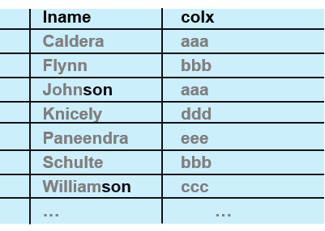
index negation; non-initial substring

Slide 61
non-initial substring (non-initial anything), solutions
why-
country → province → city
city → province → country
especially ISV/COTs applications
lead with selectivity
or; is this non-initial (data) actually an attribute
reverse index (meh)
GIN indexes

Slide 62
reverse index, syntax and use
CREATE TABLE t2 (
id BIGINT,
col1 TEXT,
col1_rev TEXT GENERATED ALWAYS AS (reverse(col1)) STORED,
PRIMARY KEY (id HASH)
);
-- Plain ascending LSM index on the reversed text -- ordinary prefix
-- range scan support, nothing exotic needed.
CREATE INDEX t2_col1_rev_idx ON t2 (col1_rev ASC);
ANALYZE t2;

Slide 63
reverse index, syntax and use
-- original query
SELECT * FROM t1 WHERE col1 LIKE '%GE AK';
-- QUERY PLAN
-- --------------------------------------------------------------------------------
-- Seq Scan on t1 (cost=21.10..61958.72 rows=9851 width=41)
-- (actual time=74.319..303.490 rows=5000 loops=1)
-- Storage Filter: (col1 ~~ '%GE AK'::text)
-- Planning Time: 41.525 ms
-- Execution Time: 317.859 ms
-- Peak Memory Usage: 81 kB

Slide 64
reverse index, syntax and use
-- query that uses reverse index
SELECT * FROM t2 WHERE col1_rev LIKE 'KA EG%';
-- QUERY PLAN
-- ---------------------------------------------------------------------------------
-- Index Scan using t2_col1_rev_idx on t2 (cost=48.20..48.49 rows=9851 width=74)
-- (actual time=19.407..69.373 rows=5000 loops=1)
-- Index Cond: ((col1_rev >= 'KA EG'::text) AND (col1_rev < 'KA EH'::text))
-- Storage Index Filter: (col1_rev ~~ 'KA EG%'::text)
-- Planning Time: 46.123 ms
-- Execution Time: 72.038 ms
-- Peak Memory Usage: 103 kB

Slide 65
GIN index, generalized inverted index
not a TF/IDF (term frequency, inverse document frequency index), ala Solr/Lucene
generalized, decomposes indexed value into set of keys
array elements for arrays
keys/values for JSONB
trigrams for pg_trgm
inverted, meaning; keys, then the list of rows containing it, but it fans in, not out

Slide 66
GIN index, generalized inverted index
SELECT show_trgm('Hello World');
-- show_trgm
-- ---------------------------------------------------------------
-- {" h"," w"," he"," wo", ell, hel, "ld ", llo, "lo ", orl, rld, wor}
-- UI nit; data is returned sorted, deduplicated, not in source word order
-- pads at blank space boundaries; 2 leading, 1 trailing

Slide 67
example 03
solution
© 2026 All Rights Reserved

Slide 68
example 03: creating a GIN index
CREATE TABLE t3 (
id BIGINT,
col1 TEXT,
PRIMARY KEY (id HASH)
);
CREATE EXTENSION IF NOT EXISTS pg_trgm;
CREATE INDEX t3_col1_trgm_idx ON t3 USING gin (col1 gin_trgm_ops);
ANALYZE t3;

Slide 69
example 03: the query plan
EXPLAIN (ANALYZE)
SELECT * FROM t3 WHERE col1 LIKE '%GE AK';
-- QUERY PLAN
-- ----------------------------------------------------
-- Index Scan using t3_col1_trgm_idx on t3
-- (cost=16.00..25.71 rows=98 width=41)
-- (actual time=23.255..947.165 rows=5000 loops=1)
-- Index Cond: (col1 ~~ '%GE AK'::text)
-- Rows Removed by Index Recheck: 200000
-- Planning Time: 42.658 ms
-- Execution Time: 949.507 ms
-- Peak Memory Usage: 135 kB
this test used highly duplicative/generated data
effectively, the index over-fetches possible matches, then fully qualifies rows (rechecks) before returning to the calling function

Slide 70
a different data set; seeing quality of query predicates, and index rechecks
a trigram index breaks text into 3-character sequences
for example:
"Yummy Donut" creates trigrams: `yum`, `umm`, `mmy`, `my `, `y d`, ` do`, `don`, `onu`, `nut`
query 1: `'%Yummy Donut%'` - 5,022,410 rechecks (85 sec)
the space in "Yummy Donut" creates the trigram `y d` (y-space-d)
this is an extremely common trigram (any word ending in 'y' followed by word starting with 'd')
index returns 5+ million candidate rows that must be rechecked
query 2: `'%Yumm%Donut%'` - 319,070 rechecks (10 sec)
no space between words means different trigrams: `mmd`, `mdo`, `don`
these are **much less common** trigrams
far fewer false positives to recheck
…

Slide 71
a different data set; seeing quality of query predicates, and index rechecks
…
query 3: `'%Yumm% Donut%'` - 5,022,376 rechecks (86 sec)
has the space, so includes `m d` trigram
again, a very common pattern (words ending in 'm' + space + 'd')
same very large recheck
query 4: `'%umm% %onut%'` - 17,114 rechecks (1.3 sec)
lowercase makes it different: `m o` trigram
the double wildcard `% %` with lowercase is less common
much better performance
…

Slide 72
a different data set; seeing quality of query predicates, and index rechecks
…
query 5: `'%Yumm% %Donut%'` - 319,070 rechecks (10 sec)
the pattern `% %` (space-space) between wildcards creates different matching
more selective than single space
case-sensitive single-character + space trigrams like `y d`, `m d`
these patterns match millions of unrelated phrases:
"Happy dog", "Very different", "My data", "eby digital", etc
github issue, #7850, a current limitation is that only one scan term is used at a time

Slide 73

what about full text search (FTS), a different use case
CREATE TABLE t4 (
id BIGINT,
col1 TEXT,
PRIMARY KEY (id HASH)
);
CREATE INDEX t4_col1_lex_idx ON t4
USING gin (to_tsvector('simple', col1));
ANALYZE t4;
EXPLAIN (ANALYZE)
SELECT * FROM t4
WHERE to_tsvector('simple', col1) @@ to_tsquery('simple', 'Golden\ Dragon:*');
FTS- a whole other set of topics, but in this example; whole word search within a larger indexed string

Slide 74
full text search, query plan
QUERY PLAN
-----------------------------------------------------------------------------------
Index Scan using t4_col1_lex_idx on t4 (cost=20.00..35.00 rows=400 width=41)
(actual time=9.992..71.995 rows=10000 loops=1)
Index Cond: (to_tsvector('simple'::regconfig, col1) @@
'''golden'':* <-> ''dragon'':*'::tsquery)
Planning Time: 9.159 ms
Execution Time: 73.904 ms
Peak Memory Usage: 78 kB

Slide 75
for permanent tables, what are the 3 index types available with yugabyteDB 2026.1
the first index type we detailed has further modifiers/adjectives for columns-
what are they named
which do you lead with ? why ?
which operators do each support
which index negation was introduced in this example
describe the workings of a reverse index
what does GIN index stand for as an acronym
in addition to trigrams, what two additional (use cases) were listed for GIN indexes
when using a GIN (trigram) index, describe briefly what an index recheck is
same data, same column, same GIN index, different search terms; why would one query return in 1 second and the other return in 30 seconds
briefly describe FTS, full text search
checkpoint
© 2026 All Rights Reserved

Slide 76
example 03
hands on exercise
exercise 03
exercise 03b
exercise 03c
© 2026 All Rights Reserved

Slide 77
discussion
random topics (housekeeping, backlog of unresolved dependencies)-
index count per table-
yugabyteDB write path
(group)
collocated indexes
index ordered tables
key only retrieval, covering indexes
© 2026 All Rights Reserved

Slide 78
index count, write path
an index is a vertical slice of a table; generally, all rows and a subset of columns
a single row write to a table with 6 indexes can be 7x the write volume
count of indexes per table for OLTP type systems-
olden times, aimed for less than 3 indexes per table (2.6-2.8) on average
modern times, it's just additional parallel, asynchronous CPU workload, disk space. not free, but also not the final word towards achieving a given SLA
modern times
we are networked, distributed, horizontally scaled
data consistency; strong or eventual
synchronous or asynchronous data replication
…

Slide 79
index count, write path
…
given 3 failure domains, 3 nodes each (9 nodes total) , replication factor 3, and a transaction writing 3 rows-
placement: each row hashes to a tablet, each tablet’s 3 replicas land one-per-domain — a full domain failure costs that tablet at most 1 replica, so the remaining 2 still form a Raft majority
per-row write: for each of the 3 rows, the tablet leader appends a provisional write (an “intent”) and replicates it to its followers via Raft consensus
write pipelining: without it, each row’s replication round would need to be acknowledged before the next row’s write is sent. with pipelined writes, the leader accepts and starts replicating the next row’s intent before the prior one’s round has finished — so the three rows’ Raft rounds overlap in flight rather than being serial
commit: once all three intents are durably replicated, the transaction commits by writing a single record to the transaction status tablet, atomically making all three rows visible together
net effect: three back-to-back network-plus-consensus round trips become three overlapping ones — wall-clock commit time drops roughly in proportion to how much overlap pipelining achieves

Slide 80
index count, write path, with indexes
same 3-row transaction, same 3×3 domain layout, but the table now has 2 secondary indexes-
indexes are their own tablets: each secondary index is itself an independently-sharded table. writing a row means writing not just its base-table tablet, but also one entry per index — and each index entry is hashed by the indexed column’s value, so it very likely lands on a different tablet (and different leader/node) than the base row itself
participant count multiplies: each of the 3 rows now touches up to 3 tablets (1 base + 2 index) instead of 1 — up to 9 participant tablets total for the one transaction, each still independently Raft-replicated across the 3 failure domains
write pipelining matters more, not less: the benefit scales with participant count — instead of overlapping 3 round trips, pipelining can now overlap up to 9, since the coordinator dispatches intents to all participant tablets concurrently rather than waiting tablet-by-tablet
still one commit: index maintenance is fully transactional, not an eventual/side write — the single commit record on the transaction status tablet atomically finalizes the base-row intents and both indexes’ intents together, so a reader can never observe the row without its index entries (or vice versa), no matter how many tablets were involved

Slide 81
(reads ?) collocated indexes, key-only retrieval, covering indexes, index ordered tables
file access method-
sequential scan; has every column you need
index (a subset of columns) retrieval; use the index to identify the rows you need, then go back to the table proper to get any remaining columns, 2 logical reads
collocated (tables) indexes
(yugabyteDB has collocated tables, a different topic, and not covered here)
Sybase 1987, Oracle 1997, Spanner 2012, but all meant slightly different things
topically clustered indexes/tables reside in this neighborhood
"attached index", index follows partitioning strategy of table proper
largely; create physical adjacency of parent and child (rows), reduce latency to retrieve
the biggest downside is creating node hot spots
…

Slide 82
(reads ?) collocated indexes, key-only retrieval, covering indexes, index ordered tables
…
yugabyteDB index ordered tables
data in table exists in key order, no separate heap layer
primary key lookup; index ordered data, and all data is present
key only retrieval
column list columns all found in index structure, no need to access table proper
can be an exception to index negation
…

Slide 83
example: key only retrieval, index negation exception
-- 200,000 rows, bucket uniformly 0-99 (so `bucket < 40` matches ~40% — poor selectivity)
CREATE TABLE t1 (
id INT,
bucket INT,
payload TEXT,
PRIMARY KEY (id HASH)
);
CREATE INDEX t1_idx ON t1 (bucket ASC);
SELECT id, bucket FROM t1 WHERE bucket < 40;
-- Seq Scan on t1 (actual time=2.044..138.039 rows=80000)
-- Storage Filter: (bucket < 40)
SELECT bucket FROM t1 WHERE bucket < 40;
-- Index Only Scan using t1_idx (actual time=0.923..19.420 rows=80000)
-- Index Cond: (bucket < 40)
-- Heap Fetches: 0

Slide 84
(reads ?) collocated indexes, key-only retrieval, covering indexes, index ordered tables
…
covering indexes
available for both unique and duplicate indexes (more commonly used for unique)
additional columns not part of (key calculation), but stored as real, directly-readable column data
why ? pick up key-only retrievals (performance)

Slide 85
example: covering index
CREATE TABLE t1 ( -- add 200k rows of data
id INT,
bucket INT,
payload TEXT,
PRIMARY KEY (id HASH)
);
EXPLAIN (ANALYZE) SELECT id, bucket FROM t1 WHERE bucket < 40;
-- Seq Scan on t1 (actual time=2.185..139.998 rows=80000 loops=1)
-- Storage Filter: (bucket < 40)
-- Execution Time: 154.017 ms
CREATE INDEX t1_bucket_idx ON t1 (bucket ASC) INCLUDE (id);
ANALYZE t1;
EXPLAIN (ANALYZE) SELECT id, bucket FROM t1 WHERE bucket < 40;
-- Index Only Scan using t1_bucket_idx on t1 (actual time=1.865..27.611 rows=80000 loops=1)
-- Index Cond: (bucket < 40)
-- Heap Fetches: 0
-- Execution Time: 44.605 ms

Slide 86
example 04
1
2
3
4
5
6
7
8
9
10
difficulty
new topics, and reinforcing what we have already covered
two table, outer join
© 2026 All Rights Reserved

Slide 87
example 04:
5 rules applied in order to determine query plan
outer joins
joins
filters
table size
table cardinality
SELECT *
FROM t1
LEFT OUTER JOIN t2
ON t1.col1 = t2.col1;
query plan
file (table) access method
join method
table order

Slide 88
outer join, what is it
one table is dominant, another inner/preserved/null-supplying
if no join pair from the inner table, populate those columns with NULLs
every row from the outer table qualifies the join condition
examples
customer → order even if the customer never placed an order
employee → department even for weird employee types (contractors ?) without a department
consider how to process if t1 is read first, versus t2

Slide 89
example 04: historically (and without exception)
SELECT *
FROM t1
LEFT OUTER JOIN t2 ON t1.col1 = t2.col1;
always-always-always read the outer table first
if you read the inner table first, you would have to go back and figure out what you are missing from the outer table. blecht
nested-loop-join (NLJ) down into the inner table
comparably super CPU and I/O intensive
at least we could batch nested loop join (BNLJ) to reduce network I/O, I/O calls
notice too, this query has no filters/ predicates

Slide 90
example 04
solution
© 2026 All Rights Reserved

Slide 91
example 04: the actual code behind this
CREATE TABLE t1 (
col1 INT,
col2 INT,
PRIMARY KEY (col1 HASH)
);
INSERT INTO t1 (col1, col2)
SELECT g, g * 2
FROM generate_series(1, 100000) AS g;
CREATE TABLE t2 (
col1 INT,
col2 INT,
PRIMARY KEY (col1 HASH)
);
INSERT INTO t2 (col1, col2)
SELECT g, g * 3
FROM generate_series(1, 10000) AS g;
ANALYZE t1;
ANALYZE t2;

Slide 92
example 04: the actual code behind this
-- QUERY PLAN
-- ---------------------------------------------------------------------------------------
-- Hash Left Join (cost=1002.61..9767.79 rows=100000 width=16)
-- (actual time=27.894..145.244 rows=100000 loops=1)
-- Hash Cond: (t1.col1 = t2.col1)
-- -> Seq Scan on t1 (cost=21.09..8523.76 rows=100000 width=8)
-- (actual time=3.513..84.543 rows=100000 loops=1)
-- -> Hash (cost=856.52..856.52 rows=10000 width=8) (actual time=24.310..24.311 rows=10000 loops=1)
-- Buckets: 16384 Batches: 1 Memory Usage: 519kB
-- -> Seq Scan on t2 (cost=21.08..856.52 rows=10000 width=8)
-- (actual time=1.677..21.353 rows=10000 loops=1)
-- Planning Time: 79.297 ms
-- Execution Time: 167.949 ms
-- Peak Memory Usage: 923 kB
3
sequentially scan t1
2
build a hash list of that result
1
sequentially scan t2

Slide 93
example 04: the actual code behind this
1
sequentially scan t2
why ?
there is no filter/predicate, you are examining every row anyway
2
build a hash list of that result from t2
why ? (there was already a hash index in place, why not use that)
these rows have to move anyway. they have to meet/join with tuples from t1
these rows will all move to a single node, in memory (work_mem)
why ?
the choices are;
nested-loop-join, move a little at a time, small targeted fetches
hash-join, move all at once
3
sequentially scan t1
why ? (same answer as above; no filter predicate)
why not also move this table ?
there is no reason to. we only examine this table one time

Slide 94
outer joins
still a major influence on the execution of the query
it is the first rule of the optimizer for a reason
(without a predicate, every row from the dominant table gets returned)
give the optimizer more options-
model the (missing department) as data, as a relation
the $0 first customer order

Slide 95
example 04: what if we disable hash join
SET enable_hashjoin = off; -- not an 'optimizer hint', actually a 'session level setting'
SET enable_mergejoin = off;
EXPLAIN (ANALYZE)
SELECT *
FROM t1
LEFT OUTER JOIN t2 ON t1.col1 = t2.col1;

Slide 96
example 04: what if we disable hash join
QUERY PLAN
----------------------------------------------------------------------------------------------------
YB Batched Nested Loop Left Join (cost=42.17..30799.29 rows=100000 width=16)
(actual time=4.415..304.477 rows=100000 loops=1)
Join Filter: (t1.col1 = t2.col1)
-> Seq Scan on t1 (cost=21.09..8523.76 rows=100000 width=8)
(actual time=1.013..16.275 rows=100000 loops=1)
-> Index Scan using t2_pkey on t2 (cost=21.08..215.30 rows=1024 width=8)
(actual time=2.314..2.331 rows=102 loops=98)
Index Cond: (col1 = ANY (ARRAY[t1.col1, $1, $2, ..., $1023]))
Planning Time: 59.343 ms
Execution Time: 321.912 ms
Peak Memory Usage: 1779 kB
-- with hash join, the first plan
--
-- Planning Time: 79.297 ms
-- Execution Time: 167.949 ms
-- Peak Memory Usage: 923 kB

Slide 97
example 04: what if there were filters
EXPLAIN (ANALYZE)
SELECT *
FROM t1
LEFT OUTER JOIN t2 ON t1.col1 = t2.col1
WHERE t1.col1 <= 100;

Slide 98
example 04: what if there were filters (a different query)
QUERY PLAN
------------------------------------------------------------------------------------------------------
YB Batched Nested Loop Left Join (cost=42.17..6098.70 rows=104 width=16)
(actual time=35.292..35.344 rows=100 loops=1)
Join Filter: (t1.col1 = t2.col1)
-> Seq Scan on t1 (cost=21.09..6057.84 rows=104 width=8)
(actual time=33.530..33.539 rows=100 loops=1)
Storage Filter: (col1 <= 100)
-> Index Scan using t2_pkey on t2 (cost=21.08..40.73 rows=104 width=8)
(actual time=1.672..1.684 rows=100 loops=1)
Index Cond: (col1 = ANY (ARRAY[t1.col1, $1, $2, ..., $1023]))
Planning Time: 77.439 ms
Execution Time: 36.627 ms
Peak Memory Usage: 659 kB
-- with hash join, the first plan
--
-- Planning Time: 79.297 ms
-- Execution Time: 167.949 ms
-- Peak Memory Usage: 923 kB
-- BNLJ, the second plan
--
Planning Time: 59.343 ms
Execution Time: 321.912 ms
Peak Memory Usage: 1779 kB

Slide 99
why are we less concerned about having 8 indexes on one table than we were umpteen years ago
write pipelining is trying to improve upon (pick one); sla delivery time, cpu utilization, ram utilization, network utilization, disk space, data consistency
what type of index retrieval might overcome an index negation
why are you more likely to use covering indexes for unique indexes versus duplicate indexes
two table outer joined select; all things being equal, which table is returning all rows
how might you model away from outer joins
how does batch nested loop join differ from nested loop join
which resource are we trying to optimize here; network, cpu, ram, disk
we've witnessed a few 'session level settings'. name one
checkpoint
© 2026 All Rights Reserved

Slide 100
example 04
hands on exercise
exercise 04
© 2026 All Rights Reserved

Slide 101
example 05
1
2
3
4
5
6
7
8
9
10
difficulty
the most costly single word modifier to any query
two tables, and a/the "select modifier"
© 2026 All Rights Reserved

Slide 102
example 05
5 rules applied in order to determine query plan
outer joins
joins
filters
table size
table cardinality
SELECT DISTINCT t1.col1, t1.col4, t1.col9, t1.col10, t2.status
FROM t1
JOIN t2 ON t1.col1 = t2.col1
WHERE t2.status = 'active';
check/ count cardinality between tables
query plan
file (table) access method
join method
table order

Slide 103

an aside: counting, and knowing what is going on-
joining two tables, creates a projection, a virtual what-if result set
a 1M row table joined with a 1M row table, creates a percentage of 1,000 billion/B row intermediate result, (percent of 1 trillion/T)
when both tables have filters, you might never see this result set. you feel it (slow query, busy CPU), but you never see it. you never return it to the client
you don’t know if you do not count
we say FJS (filter → join → sort)
but really it can be
filter → join → filter → join → filter …
check/ count cardinality between tables
we just said
but also

Slide 104
logically, how SELECT DISTINCT gets processed
process the query to get a result set
we need to do this first because a result set might come from multiple tables, or derived columns; the result set isn’t available to process until it exists
sort on the value of every column in the column list (blecht)
sorts-
all sorts are blocking operations, a total data set operation. (blocking because the last tuple produced might sort first)
distributed systems; you can push (sub-sorts) to individual nodes, but, you then have either one of two choices-
broadcast, re-distribute these sub-sorted results to complete (processing)
push the sub-sorts to a single node for the final (processing)
merge
remove adjacent duplicate entries

Slide 105
example 05: the actual code behind this
CREATE TABLE t1 (
col1 INT,
col2 INT,
col3 INT,
col4 TEXT,
col5 TEXT,
col6 INT,
col7 TIMESTAMP,
col8 NUMERIC,
col9 TEXT,
col10 TEXT,
PRIMARY KEY (col1 HASH)
);

Slide 106
example 05: the actual code behind this
INSERT INTO t1 (col1, col2, col3, col4, col5, col6, col7, col8, col9, col10)
SELECT
g,
g % 1000,
g % 50,
'name_' || g,
'category_' || (g % 20),
g % 7,
TIMESTAMP '2026-01-01' + (g % 365) * INTERVAL '1 day',
(g % 10000) / 100.0,
'ref_' || (g % 500),
repeat('The quick brown fox jumps over the lazy dog. ', 5) || 'entity #' || g
FROM generate_series(1, 100000) AS g;

Slide 107
example 05: the actual code behind this
CREATE TABLE t2 (
id BIGINT,
col1 INT,
status TEXT,
PRIMARY KEY (id HASH)
);
INSERT INTO t2 (id, col1, status)
SELECT
g,
((g - 1) % 100000) + 1,
CASE WHEN g % 3 = 0 THEN 'active' ELSE 'inactive' END
FROM generate_series(1, 1000000) AS g;
CREATE INDEX t2_col1_idx ON t2 (col1 HASH);
ANALYZE t1;
ANALYZE t2;

Slide 108
example 05: the actual code behind this
QUERY PLAN
---------------------------------------------------------------------------------------------------
Unique (cost=232668.46..236755.04 rows=200000 width=270)
(actual time=1570.274..1676.840 rows=100000 loops=1)
-> Sort (cost=232668.46..233485.77 rows=326927 width=270)
(actual time=1570.271..1598.808 rows=333333 loops=1)
Sort Key: t1.col1, t1.col4, t1.col9, t1.col10
Sort Method: external merge Disk: 92360kB
-> Hash Join (cost=35561.17..120033.22 rows=326927 width=270)
(actual time=681.834..1343.021 rows=333333 loops=1)
Hash Cond: (t2.col1 = t1.col1)
-> Seq Scan on t2 (cost=21.10..73127.94 rows=339867 width=12)
(actual time=4.819..474.296 rows=333333 loops=1)
Storage Filter: (status = 'active'::text)
-> Hash (cost=30774.07..30774.07 rows=100000 width=262)
(actual time=676.910..676.911 rows=100000 loops=1)
Buckets: 32768 Batches: 4 Memory Usage: 7582kB
-> Seq Scan on t1 (cost=21.09..30774.07 rows=100000 width=262)
(actual time=7.532..633.983 rows=100000 loops=1)
Planning Time: 55.844 ms
Execution Time: 1701.840 ms
Peak Memory Usage: 15206 kB

Slide 109
example 05
solution
© 2026 All Rights Reserved

Slide 110
SELECT DISTINCT, why are we doing this
ad-hoc and exploratory analysis
what distinct product categories had sales last quarter
occasional or one-off queries no one knew in advance. you can’t resonably model an attribute/table for this
combining multiple independent sources into one list
when it is structurally required, not just convenient-
when a join crosses a 1:M or M:M relationship, but the business question is about the "one" side only
happens infrequently, okay
happens often, should this be an attribute in the "one" side, the parent table
if you allow triggers; this can be automated. no triggers, then it's business logic
should this computation be paid for at run time, repetitively, or maintained (live)
often though, this could be a lazy add to a query that no one fully understood

Slide 111
SELECT DISTINCT, how to find/avoid/repair-
implied on prior page-
if used often, this is "state", an attribute. model as a column in a parent table
is this customer in default (payment). if this question happens often, it is state, an attribute
how to find/avoid/repair-
select count tables in the relationship; is the inner table truly a many
change the query shape
do the outer query, remove duplicates if needed
then join to a subquery (not a correlated subquery
can this be moved to a smaller set of columns. example (PostgreSQL specific, not ANSI SQL, returns first in group),
SELECT DISTINCT ON (location) location, time, report
FROM weather_reports
ORDER BY location, time DESC;

Slide 112
checkpoint
you have a list of 100 queries from your system sorted by run time descending (longest queries at the top of the list); which single, optional keyword appears in at least ¼ of the top 10 worst queries
© 2026 All Rights Reserved

Slide 113
example 05
hands on exercise
exercise 05
© 2026 All Rights Reserved

Slide 114
example 06
1
2
3
4
5
6
7
8
9
10
difficulty
common table expressions
correlated subqueries, having to consider cardinality between tables
manual query re-writes to improve query plan performance
© 2026 All Rights Reserved

Slide 115
common table expressions (CTEs)
SQL standard, SQL:1999
CTEs (the WITH clause) were formally added in the fourth major SQL revision, with ISO standards issued 1999–2002.
first commercial implementation: SQL Server 2005 — Microsoft was the first
major vendor to actually ship it, about six years after standardization
PostgreSQL — version 8.4, 2009
MariaDB — version 10.2.1
MySQL — version 8.0, 2018 — notably late, over a decade behind SQL Server

Slide 116
common table expressions (CTEs), why-
readability is the primary benefit for the common case, but there are 3 genuine, real must use CTE scenarios
1. recursive/hierarchical queries — the clearest case. a subquery cannot reference itself. full stop
2. data-modifying CTEs — genuinely unique capability, not just style
PostgreSQL/YSQL let you chain an INSERT/UPDATE/DELETE ... RETURNING into a subsequent query, all in one atomic statement —
e.g., delete expired rows and insert them into an archive table in a single DML statement, rather than two separate statements in a transaction
3. explicit optimizer control via MATERIALIZED / NOT MATERIALIZED — a real capability gap

Slide 117
common table expressions (CTEs), example
WITH big_report AS MATERIALIZED (
SELECT * FROM orders -- computes ALL rows here, no filtering yet
)
SELECT * FROM big_report WHERE customer_id = 42;
big_report computes and stores every row in orders first — a full scan, materialized as a temp result — and only then filters down to customer_id = 42. The customer_id = 42 filter never gets to influence the CTE's own execution
WITH big_report AS NOT MATERIALIZED (
SELECT * FROM orders
)
SELECT * FROM big_report WHERE customer_id = 42;
same SQL text, but now the planner is allowed to effectively rewrite this as SELECT * FROM orders WHERE customer_id = 42 from the start — an index seek on customer_id, not a full scan followed by filtering

Slide 118
common table expressions (CTEs), why-
two real reasons to force it, both about control, not raw speed:
side-effect functions. if our CTE calls something like nextval() or a volatile function, NOT MATERIALIZED could let the planner evaluate it more than once (once per outer reference) — MATERIALIZED guarantees it runs exactly once, with a stable, reusable result
we know better than the planner for this specific query. sometimes the planner's guess at pushing filters in is wrong, and forcing full materialization first is actually
the default, if you specify neither, PostgreSQL/YSQL picks for you, using a simple rule:
referenced more than once, or recursive → materialized
referenced exactly once, non-recursive → not materialized (i.e., eligible for inlining/pushdown)

Slide 119
using CTEs to actually make a query faster, problem 1
SELECT c.customer_id, c.name,
(SELECT COUNT(*) FROM orders o WHERE o.customer_id = c.customer_id) AS order_count,
(SELECT SUM(o.amount) FROM orders o WHERE o.customer_id = c.customer_id) AS total_spent
FROM customers c
WHERE c.region = 'West';
for every single customer row, this fires two separate correlated subquery executions against orders — one to count, one to sum, each independently seeking/scanning for that customer's rows
for 10,000 West-region customers, that's up to 20,000 separate subquery invocations against orders, not one pass over the table
correlated subquery
blecht

Slide 120
using CTEs to actually make a query faster, problem 1
SELECT c.customer_id, c.name,
(SELECT COUNT(*) FROM orders o WHERE o.customer_id = c.customer_id) AS order_count,
(SELECT SUM(o.amount) FROM orders o WHERE o.customer_id = c.customer_id) AS total_spent
FROM customers c
WHERE c.region = 'West';
correlated subquery
always blecht
historically, correlated subqueries are always bad-
before CTEs we tried to rewrite these as joins
the issue is always cardinality; if the (inner) table produces multiple rows, now we output (n) rows from the parent, not just one row
this then caused us to use DISINCT, already covered
because we have an aggregate here, we produce one inner row

Slide 121
using CTEs to actually make a query faster, solution 1
WITH order_stats AS (
SELECT customer_id, COUNT(*) AS order_count, SUM(amount) AS total_spent
FROM orders
GROUP BY customer_id
)
SELECT c.customer_id, c.name, os.order_count, os.total_spent
FROM customers c
JOIN order_stats os ON os.customer_id = c.customer_id
WHERE c.region = 'West';
orders gets scanned and aggregated exactly once — a single GROUP BY pass producing one summary row per customer_id — and that result is joined to customers. whether we have 100 customers or 100,000, orders is still touched exactly once
the correlated version's cost scales with the number of outer rows; the CTE version's cost scales with the size of the data being aggregated, computed a single time.

Slide 122
common table expressions (CTEs), solution 1, verifying
whether the CTE version is actually faster depends on real factors —
whether orders.customer_id is indexed (the correlated version leans hard on that index existing; without it, each correlated subquery is its own mini table scan, making the slow version catastrophically slow rather than just moderately slow)
how selective the region filter is
the way to confirm, run EXPLAIN ANALYZE on both versions and look for the correlated version showing the subquery plan node repeated inside a loop (nested Loop, subplan re-executed) versus the CTE version showing one GroupAggregate or HashAggregate node feeding a single join

Slide 123
common table expressions (CTEs), other repetitive execution patterns
1
same non-correlated subquery pasted in multiple places
multiple UNION branches each re-filtering the same expensive base
repeated self-joins to the same huge table for period comparisons
repeated complex expression case
2
3
4

Slide 124
CTEs, same non-correlated subquery pasted in multiple places, problem
SELECT customer_id,
(SELECT AVG(amount) FROM orders WHERE order_date >= '2026-01-01') AS company_avg,
amount,
amount - (SELECT AVG(amount) FROM orders WHERE order_date >= '2026-01-01') AS diff_from_avg
FROM orders
WHERE amount > (SELECT AVG(amount) FROM orders WHERE order_date >= '2026-01-01') * 2;
same AVG(amount) calculation over the same date-filtered orders table appears three separate times — it's not correlated (doesn't depend on the outer row), but many optimizers still won't recognize "these three subqueries are textually identical" and dedupe them automatically
1

Slide 125
CTEs, same non-correlated subquery pasted in multiple places, solution
WITH company_avg AS (
SELECT AVG(amount) AS avg_amount FROM orders WHERE order_date >= '2026-01-01'
)
SELECT
o.customer_id, ca.avg_amount AS company_avg, o.amount,
o.amount - ca.avg_amount AS diff_from_avg
FROM orders o, company_avg ca
WHERE o.amount > ca.avg_amount * 2;
1

Slide 126
CTEs, multiple UNION branches each re-filtering the same expensive base, problem
-- slow, the expensive join+filter runs independently in each branch
--
SELECT 'high_value' AS segment, COUNT(*)
FROM orders o JOIN customers c ON c.customer_id = o.customer_id
WHERE c.region = 'West' AND o.amount > 1000
UNION ALL
SELECT 'repeat_buyer', COUNT(*)
FROM orders o JOIN customers c ON c.customer_id = o.customer_id
WHERE c.region = 'West' AND o.order_count > 5;
both branches independently redo the same orders JOIN customers WHERE region = 'West' work
2

Slide 127
CTEs, multiple UNION branches each re-filtering the same expensive base, solution
WITH west_orders AS (
SELECT o.* FROM orders o JOIN customers c ON c.customer_id = o.customer_id
WHERE c.region = 'West'
)
SELECT 'high_value', COUNT(*) FROM west_orders WHERE amount > 1000
UNION ALL
SELECT 'repeat_buyer', COUNT(*) FROM west_orders WHERE order_count > 5;
2

Slide 128
CTEs, repeated self-joins to the same huge table for period comparisons, problem
-- Slow: orders gets independently scanned/filtered twice, once per period
--
SELECT c.customer_id,
SUM(CASE WHEN o1.order_date >= '2026-06-01' THEN o1.amount END) AS this_period,
SUM(CASE WHEN o2.order_date >= '2026-01-01' AND o2.order_date < '2026-06-01' THEN o2.amount END) AS last_period
FROM customers c
LEFT JOIN orders o1 ON o1.customer_id = c.customer_id AND o1.order_date >= '2026-06-01'
LEFT JOIN orders o2 ON o2.customer_id = c.customer_id AND o2.order_date >= '2026-01-01' AND o2.order_date < '2026-06-01'
GROUP BY c.customer_id;
orders gets joined to twice, each join independently scanning/filtering the whole table for its own date window
3

Slide 129
CTEs, repeated self-joins to the same huge table for period comparisons, solution
-- pre-aggregate each period once into its own small CTE, then join those small results
-- instead of the raw table:
WITH
this_period AS (
SELECT customer_id, SUM(amount) AS total FROM orders
WHERE order_date >= '2026-06-01' GROUP BY customer_id
),
last_period AS (
SELECT customer_id, SUM(amount) AS total FROM orders
WHERE order_date >= '2026-01-01' AND order_date < '2026-06-01' GROUP BY customer_id
)
SELECT c.customer_id, tp.total AS this_period, lp.total AS last_period
FROM customers c
LEFT JOIN this_period tp ON tp.customer_id = c.customer_id
LEFT JOIN last_period lp ON lp.customer_id = c.customer_id;
3

Slide 130
CTEs, repeated complex expression case, problem (vector search example)
SELECT id, content, embedding <=> '[0.12, 0.05, ...]' AS distance
FROM documents
WHERE embedding <=> '[0.12, 0.05, ...]' < 0.3
ORDER BY embedding <=> '[0.12, 0.05, ...]'
LIMIT 10;
that embedding <=> '[...]' (cosine/L2 distance against your query vector) shows up once in SELECT, once in WHERE, once in ORDER BY
unlike a cheap predicate like region = 'West', computing vector distance is real, non-trivial per-row math across every dimension of the embedding
repeating it three times per row roughly triples that cost, and Postgres/YSQL doesn't automatically recognize "these three expressions are textually identical, compute once" the way you might assume — each clause gets evaluated independently
4

Slide 131
CTEs, repeated complex expression case, solution
WITH scored AS (
SELECT id, content, embedding <=> '[0.12, 0.05, ...]' AS distance
FROM documents
)
SELECT id, content, distance
FROM scored
WHERE distance < 0.3
ORDER BY distance
LIMIT 10;
the expensive vector-distance calculation runs once per row, gets a name (distance), and everything downstream just references that already-computed value
4

Slide 132
example 06: the actual code behind this
-- t1 = the "one side" table (e.g. customers), 20,000 rows
CREATE TABLE t1 (
col1 INT PRIMARY KEY, -- entity id
col2 TEXT -- category/region, used as a filter
);
-- t2 = the "many side" table (e.g. orders), 100,000 rows
CREATE TABLE t2 (
col1 INT PRIMARY KEY, -- row id
col2 INT, -- foreign key back to t1.col1
col3 NUMERIC(10,2) -- a numeric value to aggregate
);

Slide 133
example 06: the actual code behind this
CREATE INDEX idx_t2_col2 ON t2 (col2 ASC);
-- 20,000 rows into t1, evenly split across 4 categories
INSERT INTO t1 (col1, col2)
SELECT g,
CASE WHEN g % 4 = 0 THEN 'West'
WHEN g % 4 = 1 THEN 'East'
WHEN g % 4 = 2 THEN 'North'
ELSE 'South' END
FROM generate_series(1, 20000) g;

Slide 134
example 06: the actual code behind this
-- 100,000 rows into t2, ~5 rows per t1 entity on average
INSERT INTO t2 (col1, col2, col3)
SELECT g, ((g % 20000) + 1), (random() * 500)::numeric(10,2)
FROM generate_series(1, 100000) g;
ANALYZE t1;
ANALYZE t2;

Slide 135
example 06:
5 rules applied in order to determine query plan
outer joins
joins
filters
table size
table cardinality
EXPLAIN (ANALYZE, BUFFERS)
SELECT t1.col1, t1.col2,
(SELECT COUNT(*) FROM t2 WHERE t2.col2 = t1.col1) AS row_count,
(SELECT SUM(t2.col3) FROM t2 WHERE t2.col2 = t1.col1) AS total_val
FROM t1
WHERE t1.col2 = 'West';
query plan
file (table) access method
join method
table order

Slide 136
example 06: how does this query execute
  how many tables do we have
what relationship do the tables have (we did discuss this)
what is the cardinality between the tables
what is the access method per table
which table is read first
generally, what performance do we expect
what manual re-write should we consider and why
improve readability/maintenance
and …
are we missing an index ? what query would we run to check if should create that index
EXPLAIN (ANALYZE, BUFFERS)
SELECT t1.col1, t1.col2,
(SELECT COUNT(*) FROM t2
WHERE t2.col2 = t1.col1) AS row_count,
(SELECT SUM(t2.col3) FROM t2
WHERE t2.col2 = t1.col1) AS total_val
FROM t1
WHERE t1.col2 = 'West';
we didn’t detail the aggregate method names

Slide 137
example 06
solution
© 2026 All Rights Reserved

Slide 138
example 06:
  SubPlan — a correlated (or sometimes uncorrelated) subquery executed as its own mini-plan, potentially many times, one per outer row. this is what we have
  not able to batch nested loop join across SubPlan boundaries
  and, when distributed, these are RPC calls/costs, not just a cached, local result
  InitPlan (not shown) — the uncorrelated special case: a subquery with no reference to the outer row, so it only needs to run once total (its result is a constant reused for every outer row)
QUERY PLAN
------------------------------------------------------------------
Seq Scan on t1 (cost=21.09..370083.31 rows=5000 width=49)
(actual time=5.216..16155.093 rows=5000 loops=1)
Storage Filter: (col2 = 'West'::text)
SubPlan 1
-> Finalize Aggregate (cost=24.42..24.43 rows=1 width=8)
(actual time=1.118..1.119 rows=1 loops=5000)
-> Index Only Scan using idx_t2_col2 on t2 (cost=24.09..24.41 rows=5 width=0)
(actual time=1.095..1.098 rows=1 loops=5000)
Index Cond: (col2 = t1.col1)
Heap Fetches: 0
Partial Aggregate: true
SubPlan 2
-> Aggregate (cost=49.30..49.31 rows=1 width=32)
(actual time=2.105..2.105 rows=1 loops=5000)
-> Index Scan using idx_t2_col2 on t2 t2_1 (cost=48.18..49.28 rows=5 width=6)
(actual time=2.077..2.082 rows=5 loops=5000)
Index Cond: (col2 = t1.col1)
Planning Time: 18.111 ms
Execution Time: 16159.895 ms
Peak Memory Usage: 717 kB

Slide 139
example 06b: manual rewrite
EXPLAIN (ANALYZE, BUFFERS)
WITH agg AS (
SELECT col2 AS entity_id, COUNT(*) AS row_count, SUM(col3) AS total_val
FROM t2
GROUP BY col2
)
SELECT t1.col1, t1.col2, agg.row_count, agg.total_val
FROM t1
JOIN agg ON agg.entity_id = t1.col1
WHERE t1.col2 = 'West';

Slide 140
example 06b: manual rewrite
QUERY PLAN
------------------------------------------------------------------------------------------------------------------------
Hash Join (cost=11498.26..12110.88 rows=4991 width=49) (actual time=150.750..164.493 rows=5000 loops=1)
Hash Cond: (t2.col2 = t1.col1)
Buffers: temp read=60 written=129
-> HashAggregate (cost=10054.70..10304.24 rows=19963 width=44) (actual time=144.144..152.721 rows=20000 loops=1)
Group Key: t2.col2
Batches: 5 Memory Usage: 8241kB Disk Usage: 696kB
Buffers: temp read=60 written=129
-> Seq Scan on t2 (cost=21.09..9304.70 rows=100000 width=10) (actual time=1.407..93.302 rows=100000 loops=1)
-> Hash (cost=1381.05..1381.05 rows=5000 width=9) (actual time=6.570..6.571 rows=5000 loops=1)
Buckets: 8192 Batches: 1 Memory Usage: 265kB
-> Seq Scan on t1 (cost=21.09..1381.05 rows=5000 width=9) (actual time=1.281..5.344 rows=5000 loops=1)
Storage Filter: (col2 = 'West'::text)
Planning Time: 17.392 ms
Execution Time: 165.904 ms
Peak Memory Usage: 8932 kB
  -- the first plan
Planning Time: 18.111 ms
Execution Time: 16159.895 ms

Slide 141

example 06: what else can be done

Slide 142
example 06c: what else can be done
tuning
result
verdict
SET work_mem = '64MB'
~137ms, Batches: 1 (no disk spill)
modest win (~17%), free/no schema change
filter t2 via join before aggregating (CTE pre-filters to West’s 5,000 entities, then aggregates only their rows)
~142ms
wash — the batched-nested-loop probe into the index to pre-filter costs about what it saves in aggregation. Not worth the added complexity here.
covering index: CREATE INDEX idx_t2_col2_covering ON t2 (col2 ASC) INCLUDE (col3)
~73ms
clear winner — ~2.3x over baseline

Slide 143
CTEs (why)
readability, (surface nesting, other)
required for-
recursion/hierarchical
data modifying
explicit control
reduce repetition (optimization, one-pass versus n probes)
same subquery in multiple places
multiple union branches with filter/re-filter
repetitive self joins
repetitive complex expressions
non-correlated/correlated subqueries
count, understand operations inside query execution; filters, cardinality between joined tables
checkpoint
© 2026 All Rights Reserved

Slide 144
example 06
hands on exercise
exercise 06b
© 2026 All Rights Reserved

Slide 145
discussion
rules based optimizers
the last two rules
cost based optimizers (CBO)
the CBO pipeline
what actually gets compared
what statistics actually contain
query optimizer hints
© 2026 All Rights Reserved

Slide 146
rules based optimizers: the last two rules
select *
from t1, t2
where
t1.col1 = t2.col1
and
t1.col1 = 5
and
t2.col2 > 5
order by
t2.col2;
5 rules applied in order to determine query plan
outer joins
joins
filters
table size (a statistic, worst table first)
table cardinality
query plan
file (table) access method
join method
table order

Slide 147
the cost based optimizer (CBO) pipeline
1.) parse & rewrite — normalize the query, flatten eligible subqueries/views into the main plan
2.) generate candidate plans — different access paths, join orders, join algorithms, aggregation strategies
3.) estimate cardinality for every sub-step, using table/column statistics
4.) apply cost formulas — I/O cost (sequential vs. random page reads) + CPU cost (per-tuple processing)
5.) compare total costs across candidates
6.) select the minimum-cost plan and execute (or cache it for reuse)

Slide 148
what actually gets compared
access path per table: sequential scan, index scan, index-only scan, bitmap scan
join order: which table drives, which is probed — grows combinatorially as tables are added (3+ tables → real search problem, not a lookup)
join algorithm: nested loop, batched nested loop, hash join, merge join
aggregation strategy: hash aggregate vs. sorted/group aggregate
materialization choices: inline a CTE vs. materialize it; flatten a subquery into a join vs. keep it as a SubPlan
search space explosion is why query planners fall back to heuristics/genetic search past a certain table count (e.g., Postgres’s GEQO)

Slide 149
what statistics actually contain (table and column level)
table-level:
estimated row count, disk page count
per column (Postgres/YSQL pg_stats):
null_frac — fraction of NULLs
avg_width — average stored byte size
n_distinct — distinct-value estimate
most_common_vals / most_common_freqs — explicit top-N values and their exact frequencies (the MCV list)
histogram_bounds — equi-depth buckets covering everything not in the MCV list
correlation — how closely physical storage order matches sorted order (-1 to 1); affects the cost of range/ORDER BY scans

Slide 150
what statistics actually contain (beyond single columns)
extended/multivariate statistics (CREATE STATISTICS) — fixes the default “columns are independent” assumption:
combined n_distinct across a column group
functional-dependency strength between correlated columns
multivariate MCV lists
index-level stats — index size, distinct key values under that index
freshness matters as much as accuracy: gathered by ANALYZE (manual or autovacuum-triggered); sample size is configurable — stale or under-sampled stats produce bad cardinality estimates regardless of how good the cost formulas are

Slide 151
atop distributed
classic statistics answer [ how many rows ]. a distributed cost model also needs: how many tablets does this plan touch, and what does each network round-trip cost
batching changes the arithmetic: a batched nested loop join folds up to ~1,024 join keys into a single RPC instead of one-per-row — same underlying statistics, very different real cost
Proof from our previous examples, same cluster, same table stats:
exercise 06 (correlated subqueries, one RPC-equivalent probe per row): ~16.2s
exercise 06b (rewritten as one GROUP BY pass): ~166ms
same optimizer, same statistics on t1/t2 — the ~100x gap came entirely from how many round trips each query shape required
on a distributed database, query shape interacts with the cost model as strongly as the statistics do

Slide 152
query optimizer hints
a directive embedded in or near a SQL statement that overrides the query optimizer’s own cost-based choice
changes how the engine gets the answer, never what the answer is
exists because the optimizer’s statistics or cost model can be wrong, stale, or simply absent for an edge case
treated by most vendors as a last resort, not a first-line tuning tool

Slide 153
what optimizer hints typically control
table join order — which table drives the query, which gets probed
join algorithm — nested loop vs. hash join vs. merge join
access path per file/table — sequential scan vs. index scan vs. index-only scan vs. bitmap scan
occasionally: parallelism degree, materialization points, or manual row/cost estimate overrides

Slide 154
two ways to hint in PostgreSQL/yugabyteDB
pg_hint_plan extension — structured hints inside a /*+ ... */ comment placed directly above the query
session-level GUCs — SET enable_hashjoin = off; etc. — blunter, disables a whole strategy class for the entire session
the two combine well: GUCs remove entire categories of alternative plans, hints pin the exact remaining choice
both require the hinting mechanism to be installed/enabled server-side (pg_hint_plan must be in shared_preload_libraries)

Slide 155
query optimizer hints: good use, bad use
good use
reproducing a historical/vendor-reported plan; a short-term stopgap while the real fix (statistics, indexing) is rolled out
working around a known, narrow optimizer blind spot
bad use:
a permanent substitute for accurate statistics or proper index design
the risk:
a hint that’s correct today can force a bad plan tomorrow once data volume or distribution shifts — the optimizer would have adapted on its own; a hint won’t

Slide 156
query optimizer hints example
SET enable_hashjoin = off;
SET enable_mergejoin = off;
SET enable_seqscan = off;
/*+
Leading(((t1 t2) t3))
NestLoop(t1 t2)
NestLoop(t1 t2 t3)
IndexScan(t1 idx_t1_col1_col2)
IndexScan(t2 idx_t2_col1_col2_col3)
IndexScan(t3 t3_pkey)
*/
EXPLAIN (ANALYZE, BUFFERS)
SELECT t1.col1, t1.col2, t2.col3, t3.col1
FROM t1, t2, t3
WHERE t1.col1 = 'LA'
AND t1.col2 = t2.col1
AND t2.col3 = 'FLT-00025'
AND t2.col3 = t3.col1;

Slide 157
example 07
1
2
3
4
5
6
7
8
9
10
difficulty
graduation; the final example
bringing it all together
© 2026 All Rights Reserved

Slide 158
example 07: graduation, the "upside down filter problem"
originally-
5 minute query down to subsecond (was rules based)
now, cost based, the query optimizer knows; no chance, do this differently, but still slow
classic pattern, happens often with ISV/COTS software, reinforces all we have discussed
and reinforces how cost based is much better
we use hints to show it totally broken
how would you observe this, look to improve
then run pure cost based
then run even more highly optimized run time (better indexes)

Slide 159
example 07: the code behind this
CREATE TABLE t1 (
col1 TEXT,
col2 TEXT,
col3 INT,
col4 TEXT,
col5 TEXT,
col6 TIMESTAMP,
col7 NUMERIC(10,2),
col8 TEXT,
PRIMARY KEY (col1 HASH, col2 ASC)
);

Slide 160
example 07: the code behind this
CREATE TABLE t2 (
id BIGINT,
col1 TEXT,
col2 SMALLINT,
col3 TEXT,
PRIMARY KEY (id HASH)
);
CREATE INDEX idx_t2_col1_col2_col3 ON t2 (col1 HASH, col2 ASC, col3 ASC);

Slide 161
example 07: the code behind this
CREATE TABLE t3 (
col1 TEXT,
col2 TEXT,
col3 INT,
col4 TEXT,
col5 TEXT,
col6 TIMESTAMP,
col7 NUMERIC(10,2),
col8 TEXT,
PRIMARY KEY (col1 HASH)
);

Slide 162
example 07:
5 rules applied in order to determine query plan
outer joins
joins
filters
table size
table cardinality
SELECT t1.col1, t1.col2, t2.col3, t3.col1
FROM t1, t2, t3
WHERE
t1.col1 = 'LA'
AND
t1.col2 = t2.col1
AND
t2.col3 = 'FLT-00025'
AND
t2.col3 = t3.col1;
query plan
file (table) access method
join method
table order

Slide 163



example 07: gather information
t1
54 columns
55,000 rows
507 byte rows
4 indexes
2 unique
2 duplicate
t3
146 columns
70,000 rows
1223 byte rows
4 indexes
2 unique
2 duplicate
7 columns
95,000 rows
82 byte row length
7 indexes
1 unique
6 duplicate
1 select, 3 tables
3-5 minute response
return 700 rows
(1-2 rows per second)
t2

Slide 164
example 07: information, explain
FILTER t1.col1 = LITERAL
query plan table order, t1, t2, then t3
SELECT * WHERE ...
col1 TEXT
col2 TEXT
------------
Unique index
(col1, col2)
t3
1
col1 TEXT
------------
Unique index
(col1)
t1
4
2
col1 TEXT
col2 NUMERIC
col3 TEXT
-------------
Duplicate index
(col1, col2, col3)
JOIN t2.col3 = t3.col1
JOIN t1.col2 = t2.col1
FILTER t2.col3 = LITERAL
3
t2

Slide 165
example 07: discussion
analyze did seem to indicate an efficient query plan
index → index → index
no temporary tables / temporary files
yet the SQL SELECT returned only 700 rows in three to five minutes
t3
t1
index join
index filter
t2
duplicate key-only join

Slide 166

example 07: simplify the test case
4
JOIN t2.col3 = t3.col1
t2
=
t3
t1
single column unique key
drop table t3 from the query
as expected, dropping table t3 from the query did not measurably affect the performance of the query
col1 TEXT
------------
Unique index
(col1)
M:1

Slide 167
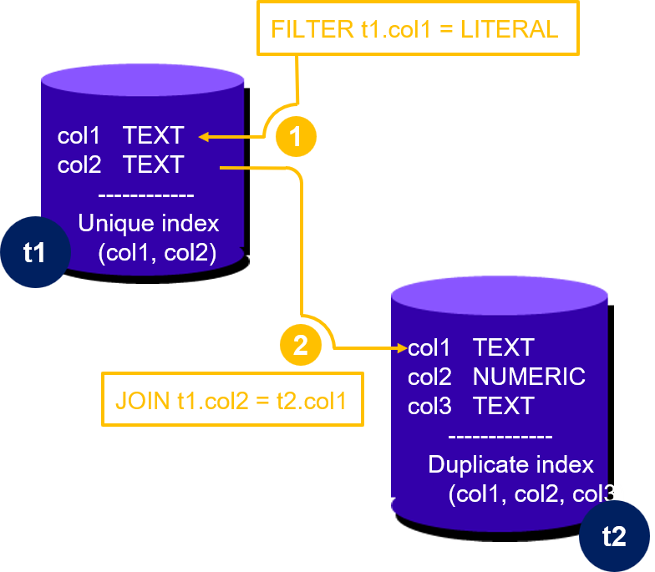
example 07: examine just tables t1 and t2
examine the performance of tables t1 and t2
examine the tables separately, and then together
167

Slide 168
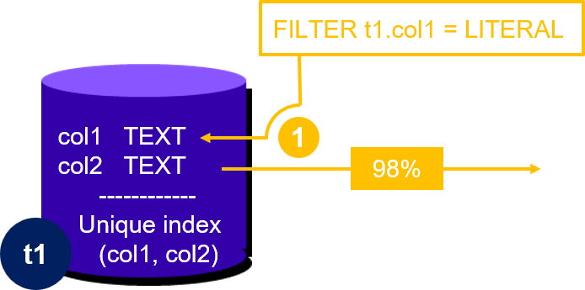
example 07: measure selectivity of filters
measure the selectivity of the filter on table t1. test performance on table t1
this was a canned application system. every data item in the database seemed to lead with a code for location. this customer only had one location

Slide 169


about unique constraints
the unique index on table t1 was required from a business rule stand point
it was a unique index and provided a unique constraint
duplicate data
constraints dept

Slide 170
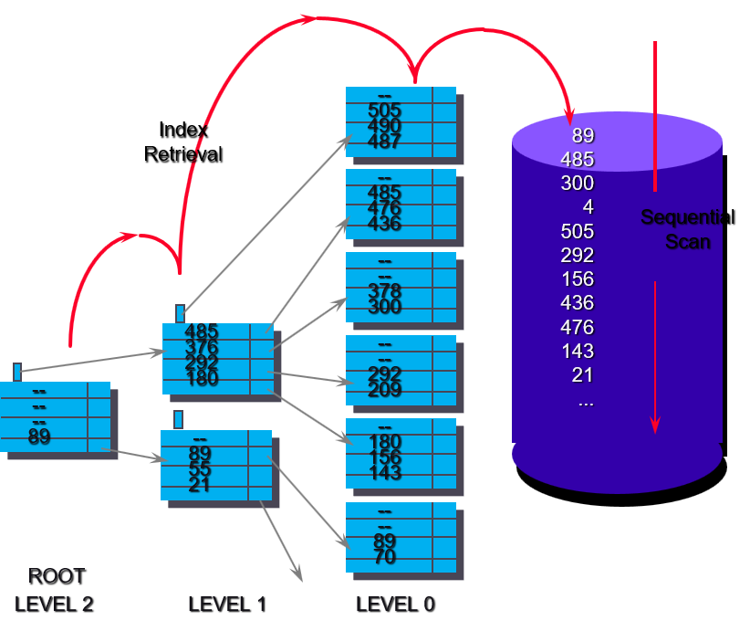
legacy systems: index versus sequential access method (B-tree+ shown)
any SQL SELECT statement that was accessing just the leading column(s) of this index for filters or join conditions would actually run faster if the index was not used; if the index was dropped or altered

Slide 171
about unique constraints
duplicate data
data duplicate
the column order of a unique constraint can be modified without violating the constraint
constraints dept

Slide 172
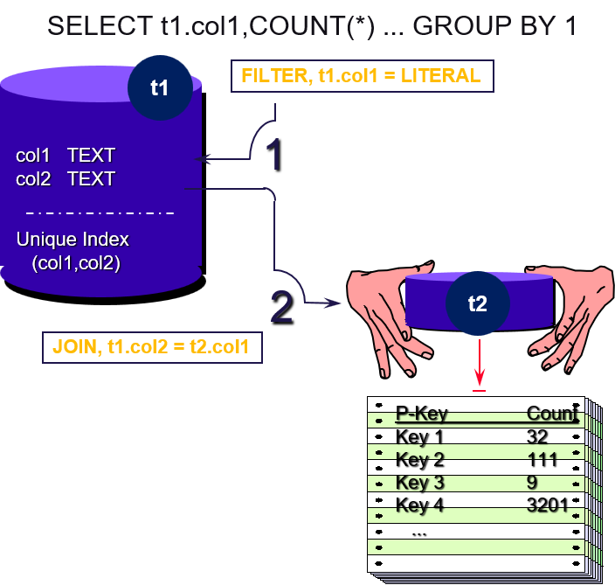
example 07: measure join relations, cardinality
compress out table t2 via an SQL GROUP BY clause. get counts of the join pairs
this query returned the primary key from table t1 and a count of the join pairs from table t2
this query informed us that anywhere between eight and 4000 rows were joined from table t2 to each single row from table t1, producing an intermediate product set of way too many rows

Slide 173
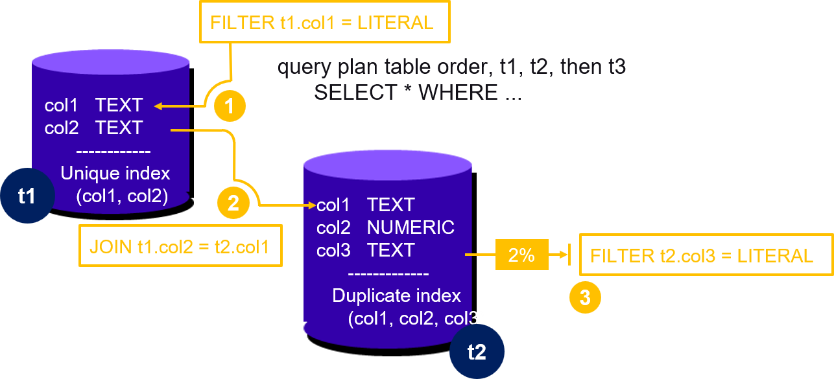
example 07: more filter measurement
the filter condition on table t2 reduced the size of the resultant data set between table t1 and table t2 to 700 rows
we were building a large intermediate product set in the midst of the join, only to discard it later

Slide 174
example 07
solution
© 2026 All Rights Reserved

Slide 175
example 07: solution
the query plan just detailed was the ~best available (rbo → cbo)
reading table t2 first is best, but that causes a default sequential scan against table t1
query run times will never (allow) a secondary table to be sequential (will not allow repetitive/nested sequential scans)
query run times will build a run time only index (hash) against t1 just for the processing of this one query. faster, but not zero seconds
the original query plan is so bad, you have to use query optimizer hints in order to replicate
cbo will build the needed index for us

Slide 176
example 07: running the really bad query
SET enable_hashjoin = off;
SET enable_mergejoin = off;
SET enable_seqscan = off;
/*+
Leading(((t1 t2) t3))
NestLoop(t1 t2)
NestLoop(t1 t2 t3)
IndexScan(t1 t1_pkey)
IndexScan(t2 idx_t2_col1_col2_col3)
IndexScan(t3 t3_pkey)
*/
EXPLAIN (ANALYZE, BUFFERS)
SELECT t1.col1, t1.col2, t2.col3, t3.col1
FROM t1, t2, t3
WHERE t1.col1 = 'LA'
AND t1.col2 = t2.col1
AND t2.col3 = 'FLT-00025'
AND t2.col3 = t3.col1;

Slide 177
example 07: query plan for the really bad query
QUERY PLAN
--------------------------------------------------------------------------------------------------
Nested Loop (cost=90.36..50107.88 rows=1890 width=38)
(actual time=11.741..382.782 rows=1900 loops=1)
-> YB Batched Nested Loop Join (cost=69.27..50063.05 rows=1890 width=28)
(actual time=10.834..380.368 rows=1900 loops=1)
Join Filter: (t1.col2 = t2.col1)
-> Index Scan using t1_pkey on t1 (cost=21.09..6873.07 rows=68591 width=18)
(actual time=2.297..19.531 rows=68600 loops=1)
Index Cond: (col1 = 'LA'::text)
-> Index Scan using idx_t2_col1_col2_col3 on t2 (cost=48.18..644.40 rows=31 width=25)
(actual time=4.886..4.894 rows=28 loops=67)
Index Cond: ((col1 = ANY (ARRAY[t1.col2, $1, $2, ..., $1023])) AND
(col3 = 'FLT-00025'::text))
-> Materialize (cost=21.09..21.21 rows=1 width=10) (actual time=0.001..0.001 rows=1 loops=1900)
-> Index Scan using t3_pkey on t3 (cost=21.09..21.20 rows=1 width=10)
(actual time=0.893..0.895 rows=1 loops=1)
Index Cond: (col1 = 'FLT-00025'::text)
Planning Time: 31.813 ms
Execution Time: 383.740 ms
Peak Memory Usage: 2049 kB

Slide 178
example 07: query plan for the really bad query
table t1 first — index Scan using t1_pkey on t1 has loops=1
t1 is scanned exactly once, filtered by col1 = 'LA', producing all 68,600 matching rows
this is the outermost driving table because it is the only index supported filter
table t2 second — Index Scan using idx_t2_col1_col2_col3 on t2 has loops=67
t2 is probed once per batch of t1.col2 values (the YB Batched Nested Loop Join packs up to ~1024 values per batch; 68,600 rows / ~1024 ≈ 67 batches)
this is the Join Filter: (t1.col2 = t2.col1) step — t2 is joined against t1’s output
table t3 last — Materialize -> Index Scan using t3_pkey on t3 has loops=1900
probed once per surviving row that made it through the t1⋈t2 join (1,900 of them)
materialize caches the single result row after the first real lookup, so the other 1,899 loops are free — but logically
t3 is joined last, against the combined t1⋈t2 result
the plan drives from t1’s weak filter (col1='LA', 98% of the table) first, joins into t2 second, and reaches t3

Slide 179
example 07b: remove the hints, allow full (modern) cbo
QUERY PLAN
--------------------------------------------------------------------------------------------------
Nested Loop (cost=63.27..6811.52 rows=1890 width=38) (actual time=26.163..41.345 rows=1900 loops=1)
-> Index Scan using t3_pkey on t3 (cost=21.09..21.20 rows=1 width=10)
(actual time=0.314..0.316 rows=1 loops=1)
Index Cond: (col1 = 'FLT-00025'::text)
-> YB Batched Nested Loop Join (cost=42.18..6771.41 rows=1890 width=28)
(actual time=25.845..40.651 rows=1900 loops=1)
Join Filter: (t1.col2 = t2.col1)
-> Seq Scan on t2 (cost=21.09..5917.47 rows=1929 width=25)
(actual time=20.370..30.504 rows=1900 loops=1)
Storage Filter: (col3 = 'FLT-00025'::text)
-> Index Scan using t1_pkey on t1 (cost=21.09..440.77 rows=1003 width=18)
(actual time=4.141..4.295 rows=816 loops=2)
Index Cond: ((col2 = ANY (ARRAY[t2.col1, $1, $2, ..., $1023])) AND (col1 = 'LA'::text))
Planning Time: 113.674 ms
Execution Time: 42.254 ms
Peak Memory Usage: 1575 kB
-- original/bad plan
Planning Time: 31.813 ms
Execution Time: 383.740 ms
Peak Memory Usage: 2049 kB

Slide 180
example 07b: remove the hints, allow full (modern) cbo
table t3 first — Index Scan using t3_pkey on t3 has loops=1
scanned once, filtered by the literal col1 = 'FLT-00025', returning its single matching row
this is the outermost/driving step — and notice it needs no join filter at all, because the optimizer recognized the transitive equality (t2.col3 = 'FLT-00025' AND t2.col3 = t3.col1 implies t3.col1 = 'FLT-00025' too) and just resolved t3 independently via the constant
table t2 second — Seq Scan on t2 has loops=1
scanned once, with col3 = 'FLT-00025' applied as a Storage Filter, producing the 1,900 candidate rows
this sits as the outer side of the YB Batched Nested Loop Join
t1 last — Index Scan using t1_pkey on t1 has loops=2
probed in batches of t2.col1 values (1,900 rows batched into ~1024-sized groups ≈ 2 loops), with Index Cond: (col2 = ANY (ARRAY[...]) AND col1 = 'LA')
both the join key and the 'LA' filter combined into one seek
this is the natural, unhinted plan (07b) — it drives from t3’s cheap point lookup first, then t2, then t1 last — the reverse of the FROM-clause order (t1, t2, t3) and the reverse of the hinted 07 plan
this reversal, chosen entirely by the cost-based optimizer with no hints involved, is exactly why this query runs in ~42ms instead of ~380ms

Slide 181
example 07c: but an even faster plan (flip the indexes over)
CREATE TABLE t4 ( -- replacement for table t1, so table t1 still exists
col1 TEXT,
col2 TEXT,
col3 INT,
col4 TEXT,
col5 TEXT,
col6 TIMESTAMP,
col7 NUMERIC(10,2),
col8 TEXT,
PRIMARY KEY (col2 HASH, col1 ASC)
);
CREATE TABLE t5 ( -- replacement for table t2, so table t2 still exists
id BIGINT, -- table t3 needed no change
col1 TEXT,
col2 SMALLINT,
col3 TEXT,
PRIMARY KEY (id HASH)
);
CREATE INDEX idx_t5_col3_col2_col1 ON t5 (col3 HASH, col2 ASC, col1 ASC);

Slide 182
example 07c: uses the original/unchanged query
QUERY PLAN
--------------------------------------------------------------------------------------------
Nested Loop (cost=66.27..739.72 rows=1914 width=38) (actual time=7.587..12.984 rows=1900 loops=1)
-> Index Scan using t3_pkey on t3 (cost=21.09..21.20 rows=1 width=10)
(actual time=0.268..0.269 rows=1 loops=1)
Index Cond: (col1 = 'FLT-00025'::text)
-> YB Batched Nested Loop Join (cost=45.18..699.38 rows=1914 width=28)
(actual time=7.315..12.277 rows=1900 loops=1)
Join Filter: (t4.col2 = t5.col1)
-> Index Only Scan using idx_t5_col3_col2_col1 on t5 (cost=24.09..207.29 rows=1951 width=25)
(actual time=0.447..0.889 rows=1900 loops=1)
Index Cond: (col3 = 'FLT-00025'::text)
Heap Fetches: 0
-> Index Scan using t4_pkey on t4 (cost=21.09..245.72 rows=1005 width=18)
(actual time=4.865..5.000 rows=700 loops=2)
Index Cond: ((col2 = ANY (ARRAY[t5.col1, $1, $2, ..., $1023])) AND (col1 = 'LA'::text))
Planning Time: 113.633 ms
Execution Time: 16.132 ms
Peak Memory Usage: 1641 kB
-- original/bad plan
Planning Time: 31.813 ms
Execution Time: 383.740 ms
Peak Memory Usage: 2049 kB
-- example 07b
Planning Time: 113.674 ms
Execution Time: 42.254 ms
Peak Memory Usage: 1575 kB

Slide 183
example 07c: cbo, and reversed indexes
table t3 first — index Scan using t3_pkey on t3 has loops=1
resolved once via the literal col1 = 'FLT-00025'
same transitive-equality reasoning as before (no join filter needed against t2/t1 at this step)
table t2 second — index Only Scan using idx_t2_col3_col2_col1 on t5 has loops=1
scanned once, and this time col3 = 'FLT-00025' is a genuine Index Cond (not a Storage Filter like t2 was) — plus Heap Fetches: 0, meaning it’s fully satisfied from the index alone
this is the reordered index doing its job.
t1 last — Index Scan using t1_pkey on t4 has loops=2: probed in batches of t2.col1 values, with Index Cond: (col2 = ANY (ARRAY[...]) AND col1 = 'LA') combining the join key and the 'LA' filter into one seek
table order t3 → t2 → t1 — the same driving order as the natural 07b plan (t3 → t2 → t1), just with the reordered-index tables substituted in
the only structural difference from 07b is t2’s access method: Index Only Scan with a true Index Cond instead of Seq Scan with a Storage Filter
the ~3x speedup (07b’s ~42ms → this plan’s ~16ms) coming entirely from the index column reorder, not from any change in join order

Slide 184
example 07
hands on exercise
exercise 07
exercise 07b
exercise 07c
© 2026 All Rights Reserved

Slide 185
example 07
(and 01 –
06)
lessons learned
in the real world, this query took 1+ hours to solve, and there could be 100(s) of these queries
creation of a "query harness"
what is this
why is it needed
how is it used throughout the entire lifecycle of an application
© 2026 All Rights Reserved

Slide 186
is schema synonymous with data model ?
data model-
attribute
defining relationships
description of
see also Relational Model
table-relationships
schema: see Data Model
relational model-
attribute
description of
diagramming
entity
join
normalizing data
projection
rules for defining tables,
rows, and columns
table-relationships
Description of Relational Model:
" .. based on the relational calculus devised
by E.F. Codd. In practical terms, it means
that all data is presented in the form of
tables comprising rows and columns. "

Slide 187
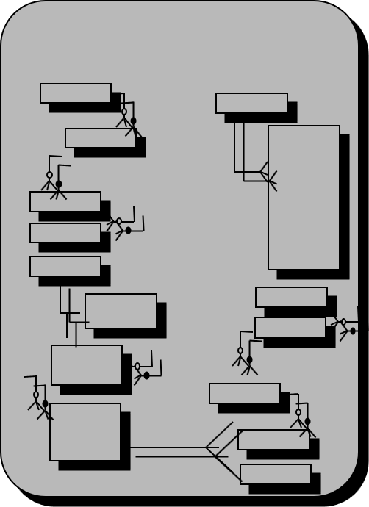
steps to create a data model
entity relationship diagram
identify principle data objects, (entities)
define relationships between entities
identify the attributes found in each entity
create an entity relationship diagram
translate the entity relationship diagram into relational constructs, (tables and columns)
resolve complex entity relationships; One to one’s, many to many’s, etc
check for compliance with Third Normal Form

Slide 188
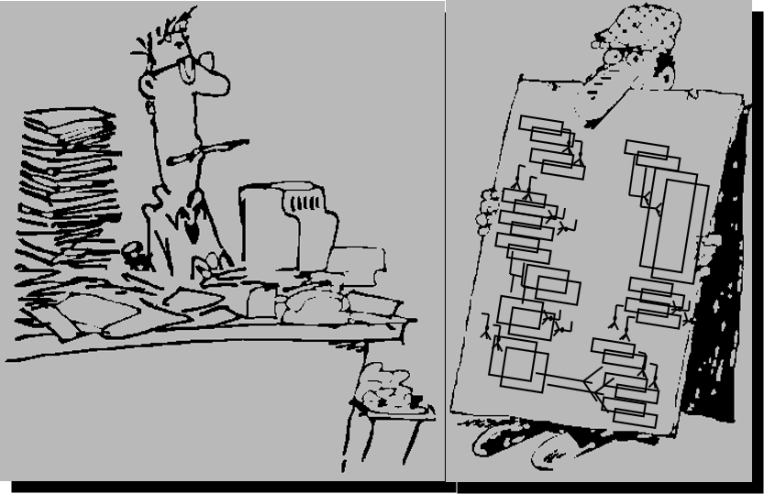
does the data model tell you
what are the steps to add a new customer order ?
what is the SQL SELECT statement for the report that I have to write ?
what is the anticipated performance of my mission critical SQL services ?
what is the plan to shelf data from this system and how do I access it later ?

Slide 189

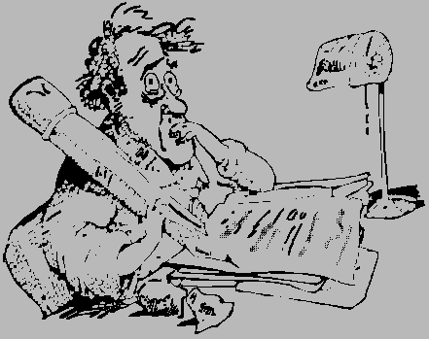

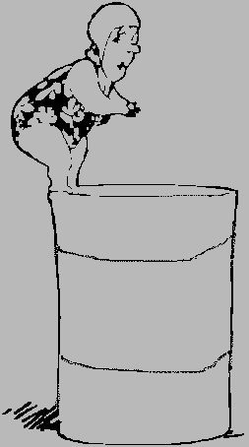
common database project time line
end user discovery
data model
coding and debugging
system test
cutover
requirements analysis
system specification
architectural design
detailed system specification
migration
integration

Slide 190
common sources of error
data admins
developers
incorrect mappings in legacy data
400 table data model
end user discovery
data model
coding and debugging
system test
cutover
missing columns
errors in schema
errors in dependencies
performance issues

Slide 191
modified time line: early cut over
legacy system data is loaded into the new system as soon as the data model is completed
loading the legacy data will uncover forgotten conditions and usages of legacy fields
development is performed with "production size" data
conversion scripts may be completed by engineers who are not on the "critical path"
allows for early measurement of the amount of work and difficulties of migrating
data cut over
…
data model
coding and debugging

Slide 192

modified time line: process model
add two more customers
a complete data model is created from the careful review of the business being performed
a process model is a record of the information that the data administrators should already have attained
the final product of a process model is a set of SQL API calls
the application developer is given the set of SQL API calls. the developer does not have to interpret a 400 table schema
no more embedded SQL statements
database server
front end
back end

Slide 193
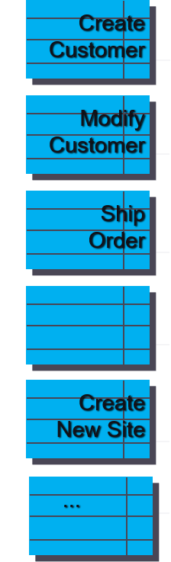
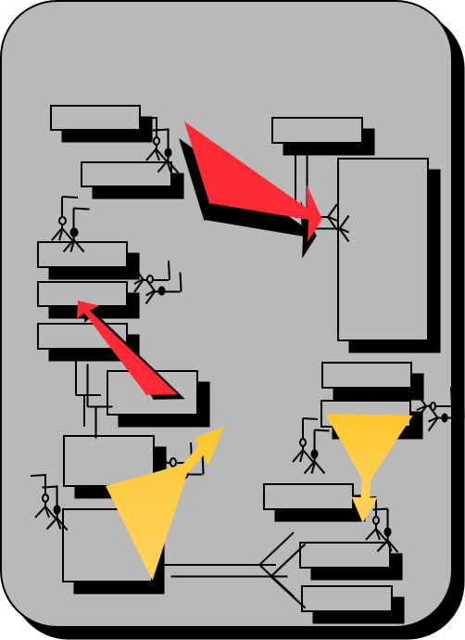
steps to create a process model
entity relationship diagram
start with the data model
list each program deliverable to be found in the application system
list every program event witnessed by each program deliverable
author the SQL DML statements associated with each program event
create SQL API calls for each distinct business function

Slide 194

does the data process model tell you
what are the steps to add a new customer order ?
what is the SQL SELECT statement for the report that I have to write ?
what is the anticipated performance of my mission critical SQL services ?
what is the plan to shelf data from this system and how do I access it later ?

Slide 195

modified time line: performance testing
SQL offers a unique capability; One SQL SELECT statement can effectively model the performance load of an entire report program
execute the authored SQL DML statements with the anticipated frequencies, concurrency and spread
check mission critical SQL services for acceptable performance
use SQL optimization techniques to increase performance before any application deliverables are created
EXPLAIN

Slide 196

modified time line: SQL optimization
besides the obvious host and database server tuning, there is one area of SQL programming that very few engineers ever become expert at; the query optimizer
understanding the query optimizer can be crucial. one 60 byte SQL SELECT statement could initiate 5M i/o calls. minor structural modifications to that SQL SELECT statement could greatly impact performance
remember our examples

Slide 197
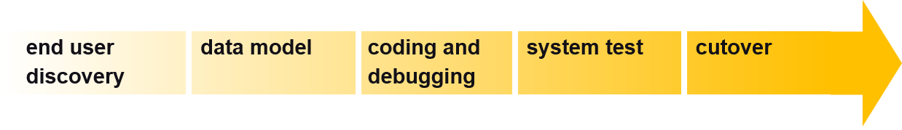
modified project time line: final
data cut over
process model
no schema interpretation
test with real data
author SQL API
performance test
aaa

Slide 198
sources of error, revisited
source of error
cost
correction
400 table schema
programmer productivity, errors in programs
programmer is handed a set of API calls
errors in data model, missing columns
changes to data model cause redevelopment
successful creation of API validates data model
performance
delays, redevelopment/ refactoring
model is performance tested prior to development
incorrect map of legacy data
creeping functionality
legacy data is checked early in process
errors in dependencies
higher maintenance, testing
API calls provide SQL programming layer

Slide 199
query plan management (qpm)
automating query monitoring, alerting on query plan regressions
history of, before qpm-
log_min_duration_statement
pg_stat_activity
pg_stat_statements
application performance monitoring, APM
active session history, ASH
query plan management (qpm)
why-
details; how
© 2026 All Rights Reserved

Slide 200
history of, before qpm-
log_min_duration_statement
2003, PostgreSQL 7.4
file based, statement by statement
only completed statements
no aggregation across nodes
pg_stat_activity
early/core PostgreSQL, changed much over the years
system table, memory based only
what is running right now, ephemeral
no aggregation across nodes
…
…
pg_stat_statements
extension, 2009, PostgreSQL 8.4
system table, memory based only
cumulative since last reset, does persist across clean restarts
no aggregation across nodes
every execution of every distinct normalized query shape — not sampled — bounded by a capacity limit
pg_stat_statements.max (default 5000 distinct query shapes)

Slide 201
pg_stat_statements, example execution
CREATE EXTENSION IF NOT EXISTS pg_stat_statements;
SELECT
LEFT(query, 100) AS statement,
calls,
mean_exec_time AS avg_ms,
max_exec_time AS max_ms,
total_exec_time AS total_ms,
rows
FROM pg_stat_statements
WHERE query ILIKE 'select%'
ORDER BY mean_exec_time DESC
LIMIT 10;

Slide 202
pg_stat_statements, example output
statement | calls | avg_ms | max_ms | total_ms | rows
--------------------------------------------+-------+---------------------+------------------+--------
SELECT t1.col1, t1.col2, t2.col3, t3.col1 +| 2 | 108.120848 | 175.159477 | 216.2416960 | 3800
FROM t1, t2, t3 +| | | | |
WHERE t1.col1 = $1 +| | | | |
AND t1.col2 = t2.col1 | | | | |
SELECT t4.col1, t4.col2, t5.col3, t3.col1 +| 1 | 14.766957 | 14.766957 | 14.7669570 | 1900
FROM t4, t5, t3 +| | | | |
WHERE t4.col1 = $1 +| | | | |
AND t4.col2 = t5.col1 | | | | |
SELECT +| 1 | 0.477873 | 0.477873 | 0.4778730 | 7
LEFT(query, $1) AS statement, +| | | | |
calls, +| | | | |
mean_exec_time AS avg_ms, +| | | | |
max_exec_time | | | | |
SELECT pg_stat_statements_reset() | 1 | 0.098783 | 0.098783 | 0.0987830 | 1
SELECT +| 0 | 0 | 0 | 0 | 0
LEFT(query, $1) AS statement, +| | | | |
calls, +| | | | |
mean_exec_time AS avg_ms, +| | | | |
max_exec_time | | | | |

Slide 203
application performance monitoring (APM)
functionally different, an application API, at 3 layers-
the SDK/tracing API your application code calls (tracer.start_as_current_span(...)) — what creates the actual trace data
OTLP (OpenTelemetry Protocol) — the wire format/API used to ship completed spans out of your process to a collector or backend (I used ConsoleSpanExporter above just to print locally; swap it for OTLPSpanExporter pointed at Datadog/Honeycomb/Jaeger and nothing else in the code changes)
the backend’s own query API — once ingested, you search/visualize traces via that vendor’s own REST/GraphQL API (or their UI, which calls the same API underneath)

Slide 204
APM, sample output
Offset (ms) Event
────────────────────────────────────────────────────────────────
0.00 http.request — request.received
8.17 http.request — request.routed_to_handler
8.26 app.handler — span starts
8.29 db.connection.acquire — pool.checkout_start
14.72 db.connection.acquire — pool.checkout_complete [ 6.43ms spent ]
14.97 db.query.execute — query.sent
251.41 db.query.execute — query.first_response [236.44ms REAL SQL TIME]
252.87 db.query.execute — query.rows_fetched [ 1.46ms fetch]
255.81 app.serialize_response — serialize.start
358.74 app.serialize_response — serialize.complete [102.93ms serialize]
359.03 app.handler — span ends
363.17 http.request — response.sent
363.19 http.request — span ends (total round trip)

Slide 205
active session history (ASH)
enabled via yb_enable_ash (confirmed on by default on this cluster), it periodically samples every active session cluster-wide and records what it was doing
data lands in a real, queryable system view: yb_active_session_history — columns include sample_time, wait_event_component, wait_event_class, wait_event, wait_event_type, query_id, pid, and more
sampling cadence and retention are tunable: yb_ash_sampling_interval_ms (1000ms here — one sample per second), yb_ash_sample_size (500 samples per component per sampling event), yb_ash_circular_buffer_size (64MB here) — a fixed-size ring buffer, so old samples age out rather than growing unbounded
bridges the gap pg_stat_activity and pg_stat_statements leave open: pg_stat_activity is live-only (no history once the query ends), pg_stat_statements is aggregated (no timeline) — ASH is the one that answers "what was this session doing, sampled over time, even after it’s finished".

Slide 206
ASH, sample output
SELECT pg_backend_pid() AS my_pid;
SELECT t1.col1, t1.col2,
(SELECT COUNT(*) FROM t2 WHERE t2.col2 = t1.col1) AS row_count,
(SELECT SUM(t2.col3) FROM t2 WHERE t2.col2 = t1.col1) AS total_val
FROM t1
WHERE t1.col2 = 'West';
-- my_pid = 1178910

Slide 207
ASH, sample output
SELECT
to_char(sample_time, 'HH24:MI:SS') AS time,
wait_event_component AS component,
wait_event_class AS class,
wait_event AS event,
wait_event_type AS type
FROM yb_active_session_history
WHERE pid = 1178910
ORDER BY sample_time;

Slide 208
ASH, sample output
Output:
time | component | class | event | type
----------+-----------+-------------+--------------+---------
11:10:41 | YSQL | TServerWait | IndexRead | RPCWait
11:10:42 | YSQL | TServerWait | IndexRead | RPCWait
11:10:43 | YSQL | TServerWait | IndexRead | RPCWait
11:10:44 | YSQL | TServerWait | TableRead | RPCWait
11:10:45 | YSQL | TServerWait | TableRead | RPCWait
11:10:46 | YSQL | TServerWait | IndexRead | RPCWait
11:10:47 | YSQL | TServerWait | IndexRead | RPCWait
11:10:48 | YSQL | TServerWait | IndexRead | RPCWait
11:10:49 | YSQL | TServerWait | IndexRead | RPCWait
11:10:50 | YSQL | TServerWait | IndexRead | RPCWait
11:10:51 | YSQL | YSQLQuery | OnCpu_Active | Cpu
11:10:52 | YSQL | TServerWait | IndexRead | RPCWait
11:10:53 | YSQL | TServerWait | IndexRead | RPCWait
11:10:54 | YSQL | TServerWait | IndexRead | RPCWait
11:10:56 | YSQL | TServerWait | IndexRead | RPCWait
11:10:57 | YSQL | TServerWait | IndexRead | RPCWait
(16 rows)

Slide 209
ASH, what can you do with this data-
the single most useful thing: it separates “why is this slow” into buckets that call for completely different remedies
dominated by IndexRead/TableRead (RPCWait) — like our example — means the time is going to network round trips to storage, not computation. the fix is architectural: fewer RPCs (batching, rewriting correlated subqueries as joins — literally what exercises 06→06b→06c did), or covering indexes to avoid extra hops
dominated by OnCpu_Active — means the time is genuine computation (sorting, aggregating, evaluating expressions). the fix is different: better join/aggregate algorithm choice, work_mem, or parallelism — not batching
dominated by lock-related wait events — a concurrency problem, not a query-shape problem. points us at transaction design, not indexing
dominated by client/idle wait — means the database isn’t the bottleneck at all. this is the tell that sends us back to the application/APM side instead of tuning SQL further — the one thing pure database-side tools can’t tell you on their own

Slide 210
query plan management (qpm): why-
we have thousands and thousands of queries (too many) to design, tune, monitor
query planner "cost" is relative across different queries
query planner "time"
the "month end summary report" query (run once per month, by a daemon) will always be 30 seconds
the "log in" query (run 100s of times per second by a live operator) must be very sub-second
data volumes grow naturally over time, change isn’t automatically an alert
if the time to complete goes up slowly over months, and the query plan is the same; normal data growth ? we good ?
if the query plan changes, and time is faster; we good ?
if the query plan changes, and time is worse by a margin; roll a truck

Slide 211
qpm, configuring
no CREATE EXTENSION needed — it’s a core, built-in mechanism (unlike pg_stat_statements), controlled by GUCs)
yb_pg_stat_plans_track — scope of tracking (default all)
yb_pg_stat_plans_max_cache_size — capacity, in distinct query/plan pairs (default 5000)
yb_pg_stat_plans_cache_replacement_algorithm — eviction policy once full (default simple_clock_lru)
yb_pg_stat_plans_plan_format — json by default
yb_pg_stat_plans_verbose_plans / yb_pg_stat_plans_show_max_exec_params — off by default, extra detail when turned on
yb_qpm_compress_text — compresses stored plan/hint text (on by default)

Slide 212
qpm, accessing
two system views, both queryable directly, no wrapper needed-
yb_pg_stat_plans — one row per distinct (query, plan) pair
queryid, planid, calls, avg_exec_time, max_exec_time, avg_est_cost
critically a hints column containing a complete, replayable pg_hint_plan-compatible string describing exactly that plan (join order, access method per table, and the planner GUC settings in effect)
yb_pg_stat_plans_insights — a higher-level view
plan_require_evaluation, min_avg_exec_time, min_avg_est_cost
specifically flag queries whose current plan is worse than a previously known one — the actual "regression detection" surface

Slide 213
qpm, in use
The single most useful query against this view: find any queryid that has more than one distinct planid — meaning the same logical query has been executed under different plans
SELECT queryid, planid, calls, avg_exec_time, avg_est_cost
FROM yb_pg_stat_plans
WHERE queryid IN (
SELECT queryid FROM yb_pg_stat_plans
GROUP BY queryid HAVING COUNT(DISTINCT planid) > 1
)
ORDER BY queryid, avg_exec_time DESC;

Slide 214
example 07, 07b specifically
the same queryid that merged into one blended row in pg_stat_statements a few turns ago is split into two distinct plans here
SELECT
RIGHT(planid::text, 8) AS plan_id,
calls,
round(avg_exec_time::numeric,1) AS avg_ms,
round(avg_est_cost::numeric,0) AS est_cost,
CASE WHEN hints LIKE '%SeqScan(t2)%' THEN 'SeqScan(t2)'
WHEN hints LIKE '%IndexOnlyScan(t2%' THEN 'IdxOnlyScan(t2)'
ELSE 'other' END AS t2_access
FROM yb_pg_stat_plans
WHERE queryid = 3958159052188978184
ORDER BY avg_exec_time DESC;

Slide 215
data output from that last query
plan_id | calls | avg_ms | est_cost | t2_access
----------+-------+--------+----------+-----------------
21637953 | 1 | 175.2 | 10989 | IdxOnlyScan(t2)
95128495 | 1 | 41.1 | 6812 | SeqScan(t2)

Slide 216
query plan management demonstration:
web program demonstration, pre-chat

Slide 217
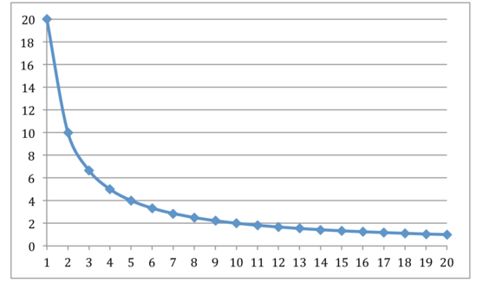
zipfian data distributions, query plans, the driver
data: 500K total rows
500 "typical" customers with ~100 rows each
3 "mega" customers with 150,000 rows each (90% of the table)
query, prepared statement, real application using connection pool/driver-
PREPARE stmt(int) AS SELECT *
FROM qo_demo_zipf WHERE customer_id = $1;
repeatedly EXECUTE stmt(XXX customer_id), a typical customer
then a mega customer
zipfian data distribution

Slide 218
zipfian data distributions, query plans, the driver
why/how it breaks-
Postgres/YSQL doesn't replan a prepared statement from scratch on every call
first few executions it uses a "custom" plan tailored to the actual bound value each time
correctly picking an Index Scan for a typical customer (cheap, ~100 matching rows)
and a Seq Scan for a mega customer (cheap relative to indexing through 150,000 individual entries)
starting around the 3rd execution, the planner evaluates switching to one reusable "generic" plan that doesn't know which value is coming next
Index Scan is the safe bet, and locks that plan in for every future call on that connection
references:
generic versus customer plans, https://www.postgresql.org/docs/current/sql-prepare.html
controlling this behavior, https://www.postgresql.org/docs/current/runtime-config-query.html
more reading, https://yugabytedb.tips/taming-prepared-statement-re‑planning-with-plan_cache_mode-in-yugabytedb/

Slide 219
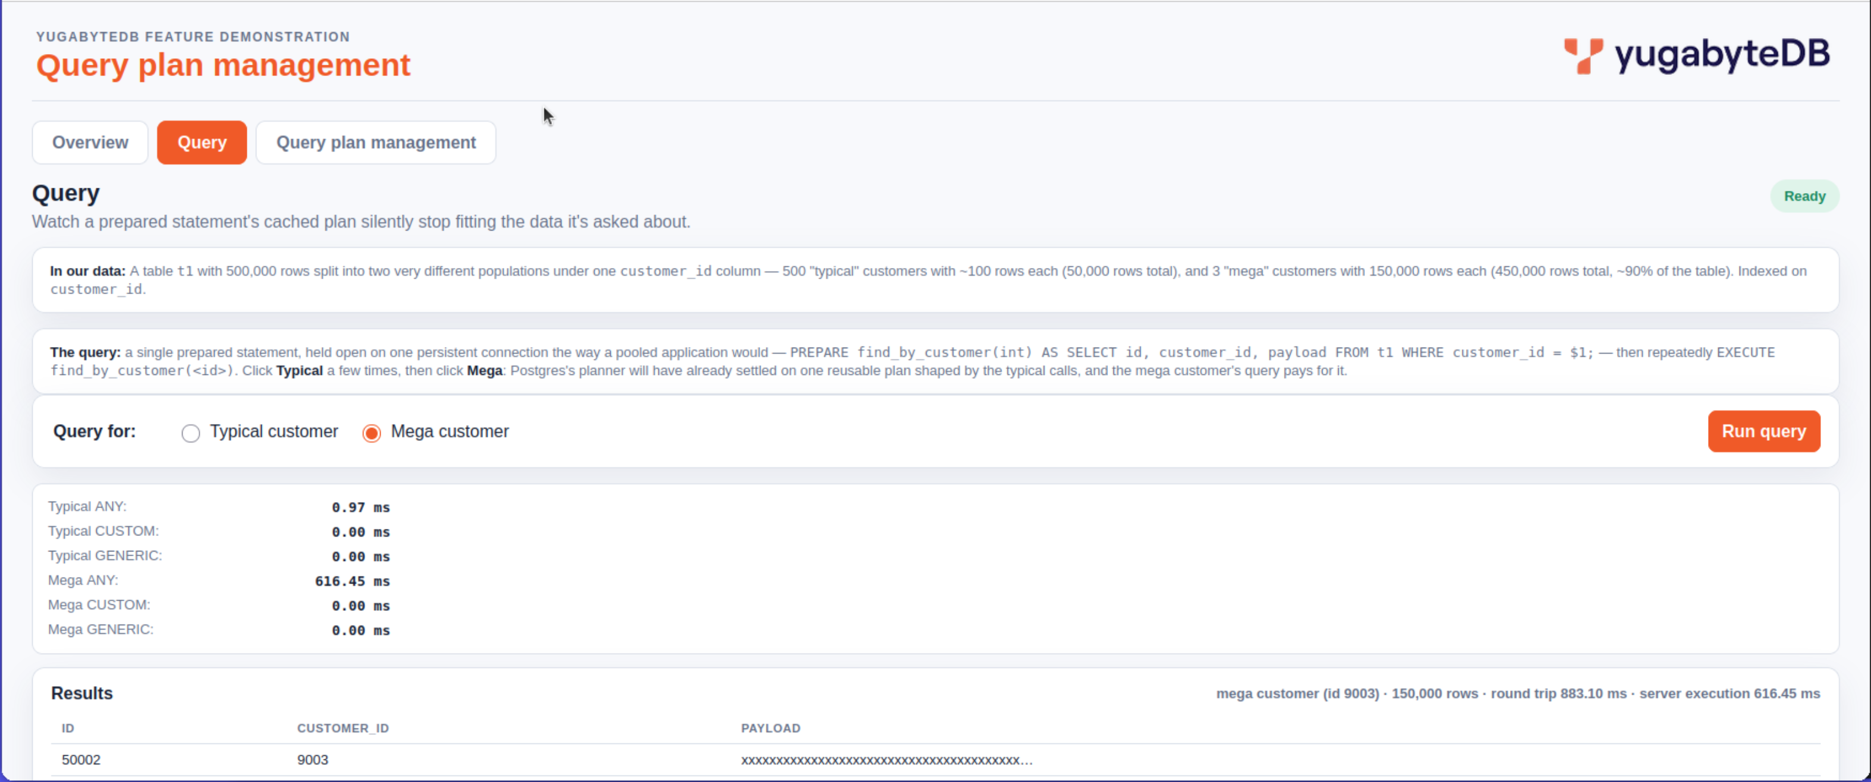
query plan management demonstration:

Slide 220
checkpoint
why was the example 07 query initially slow
why should you do a volume data test after creating the data model, and before entering the application development phase
what is a zipfian data distribution
generic|custom query plans through the driver; what do we need to know here
© 2026 All Rights Reserved

Slide 221
Next step ..
___
___
___
___

Slide 222

end
Notes:
Yugabyte was founded on the belief that the next decade will see a major change in the systems of record that enterprises use to run their businesses and offer digital services. We are the company behind YugabyteDB, a distributed SQL database built first and foremost for transactional applications and to support enterprises as they move into a cloud-native, digital-led world. The database is 100% open source and designed to run on any cloud: private, public, hybrid, multi-cloud — flexibility and openness are essential to our customers and position us uniquely in the distributed SQL market. YugabyteDB is used by both small companies and by the Fortune 500 alike - by retailers, advertisers, financial services companies, telecom and others.

Slide 223
query optimizer; what constitutes a query (execution) plan
predicate pushdown, filter placement
deciding where in the plan tree to apply a WHERE-clause filter, ideally as early as possible to reduce tuple counts before expensive operations
aggregation strategy
hash aggregate vs. sort-then-group-aggregate for GROUP BY
sort elimination
recognizing when an index already delivers tuples in the order an ORDER BY or GROUP BY needs, avoiding an explicit sort step entirely
subquery transformation
rewriting a correlated subquery into a join (or vice versa), converting IN/EXISTS into semi-joins/anti-joins, or "unnesting" subqueries into the main query when it's provably equivalent and cheaper
materialization versus pipelining
rewriting a correlated subquery into a join (or vice versa), converting IN/EXISTS into semi-joins/anti-joins, or "unnesting" subqueries into the main query when it's provably equivalent and cheaper
…

Slide 224
query optimizer; what constitutes a query (execution) plan
…
parallel execution planning
how many worker processes to use for a parallel scan/join/aggregate, and whether parallelism is even worth the coordination overhead for this particular query
partition pruning
or partitioned tables, determining which partitions can be skipped entirely based on the query's filter conditions
constants folding, expression simplification
or partitioned tables, determining which partitions can be skipped entirely based on the query's filter conditions
view/CTE inlining
whether to expand a view or CTE inline into the surrounding query (allowing cross-boundary optimization) or treat it as an optimization fence (materializing it separately)

Slide 225
aaa
aaa

Slide 226
Clip art

Slide 227
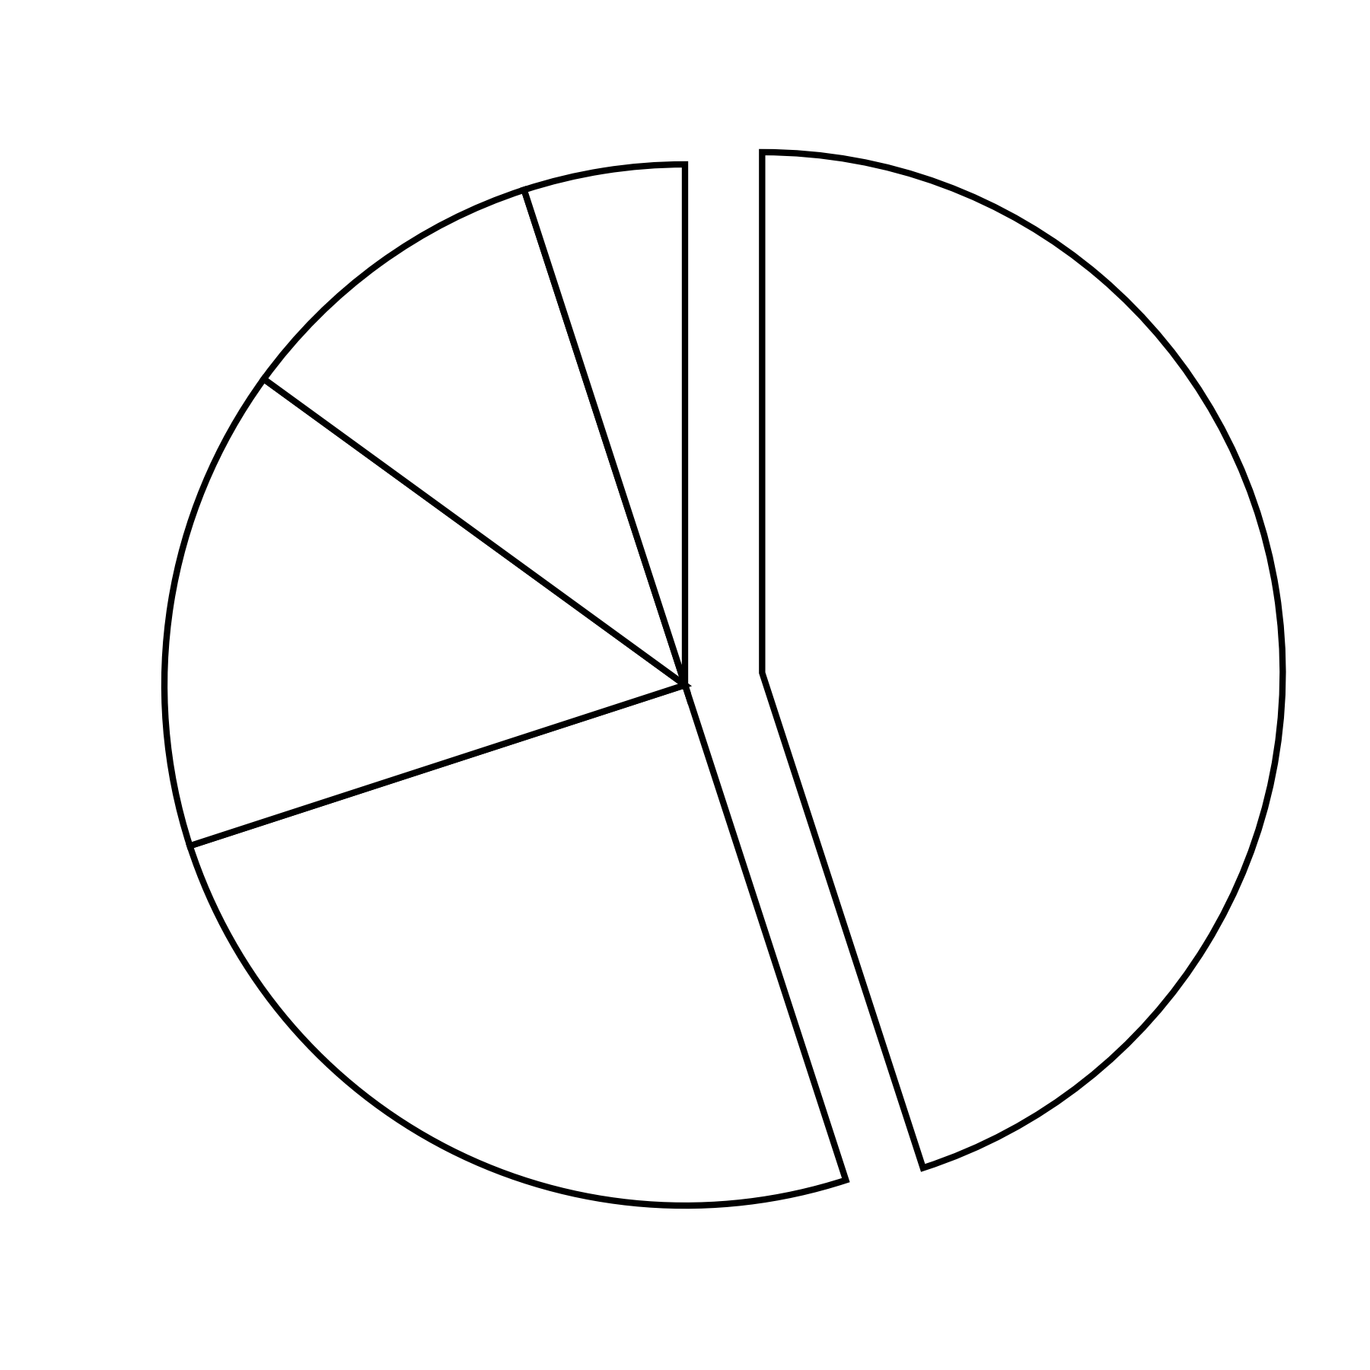

Slide 228
cust_num
col_x
order_num
order_num
order_date
101
aaa
401
401
09/01/16
102
bbb
402
402
11/12/15
103
ccc
403
403
07/07/18
104
ddd
404
404
07/07/18
105
eee
405
405
04/04/15
106
fff
406
406
03/12/12
107
ggg
407
407
08/02/18
…
…
…
…
…

Slide 229
lname
fname
lname
colx
Smite
Carly
Caldera
aaa
Smith
Alan
Flynn
bbb
Smith
Carly
Johnson
aaa
Smith
Dave
Knicely
ddd
Smith
Jim
Paneendra
eee
Smithson
Naitik
Schulte
bbb
Stang
Billie
Williamson
ccc
…
…
…
…

Slide 230
FILTER t1.col1 = LITERAL
col1 TEXT
col2 TEXT
------------
Unique index
(col1, col2)
1
t1
2
col1 TEXT
col2 NUMERIC
col3 TEXT
-------------
Duplicate index
(col1, col2, col3)
JOIN t1.col2 = t2.col1
t2

Slide 231
FILTER t1.col1 = LITERAL
col1 TEXT
col2 TEXT
------------
Unique index
(col1, col2)
1
98%
t1

Slide 232
--
505
490
487
89
485
300
4
505
292
156
436
476
143
21
...
Index
Retrieval
--
485
476
436
Sequential
Scan
--
--
378
300
485
376
292
180
--
--
292
209
--
--
--
89
--
89
55
21
--
180
156
143
--
--
89
70
ROOT
LEVEL 2
LEVEL 1
LEVEL 0

Slide 233
SELECT t1.col1,COUNT(*) ... GROUP BY 1
t1
FILTER, t1.col1 = LITERAL
1
col1 TEXT
col2 TEXT
Unique Index
(col1,col2)
2
t2
JOIN, t1.col2 = t2.col1
P-Key Count
Key 1 32
Key 2 111
Key 3 9
Key 4 3201
...

Slide 234
FILTER t1.col1 = LITERAL
query plan table order, t1, t2, then t3
SELECT * WHERE ...
col1 TEXT
col2 TEXT
------------
Unique index
(col1, col2)
1
t1
2
col1 TEXT
col2 NUMERIC
col3 TEXT
-------------
Duplicate index
(col1, col2, col3)
JOIN t1.col2 = t2.col1
FILTER t2.col3 = LITERAL
2%
3
t2

Slide 235
Create
Customer
Modify
Customer
Ship
Order
Report
Weekly Sales
Create
New Site
...

Slide 236
end user discovery
data model
coding and debugging
system test
cutover

